Slide 1
ADVANCED JAVA PROGRAMMING IN
J2EE
UNIT 3
Java Server Pages (JSP)
‹#›

Slide 2

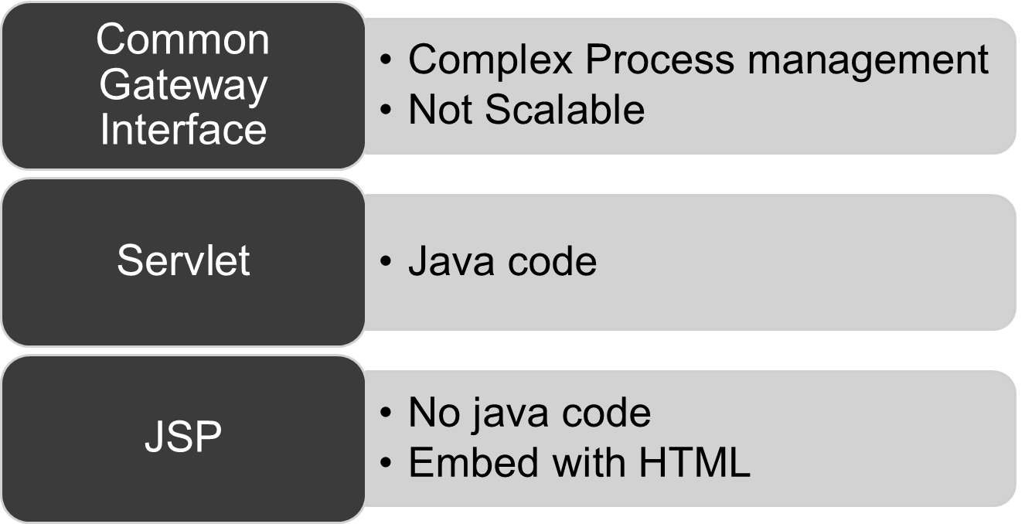

Slide 3

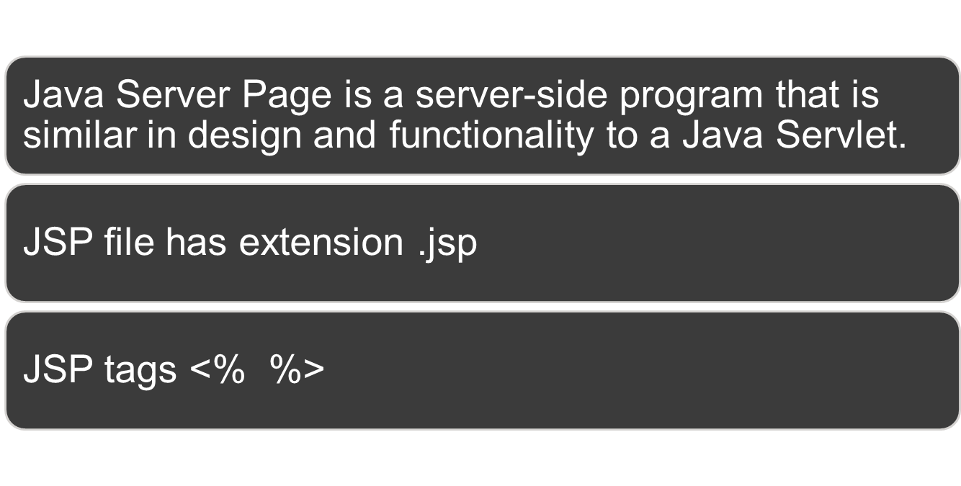

Slide 4




JSP documents
Compiled servlet
HTML documents
HTTP Request HTTP Response

Slide 5

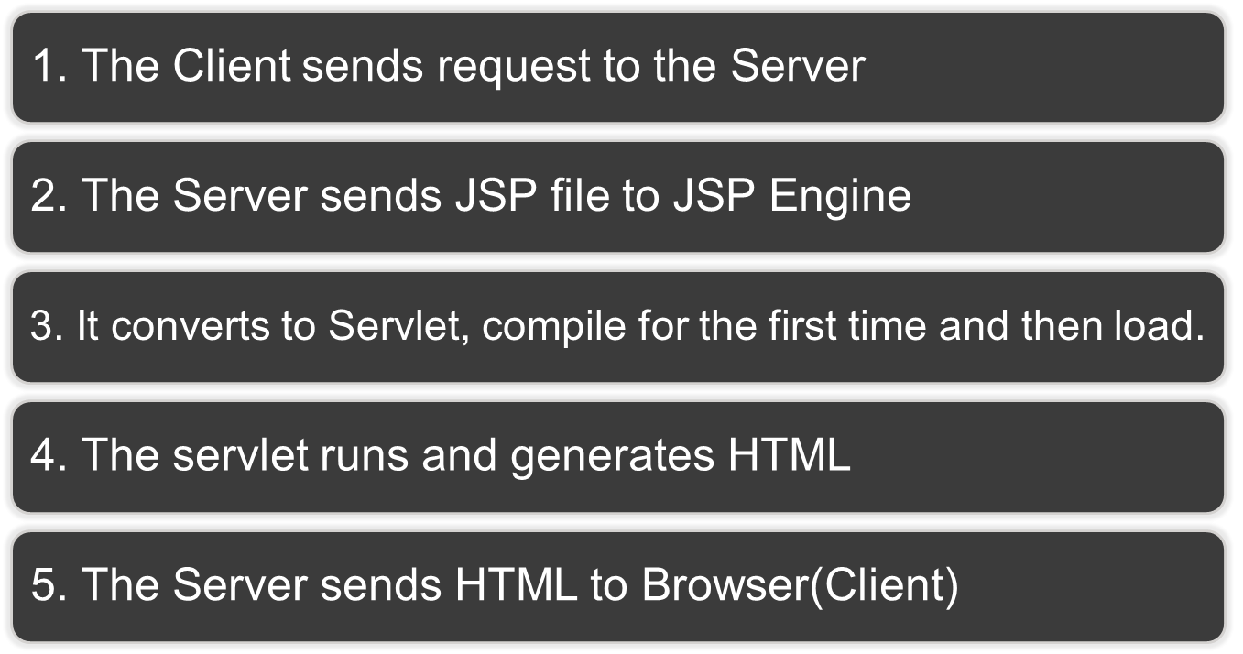

Slide 6

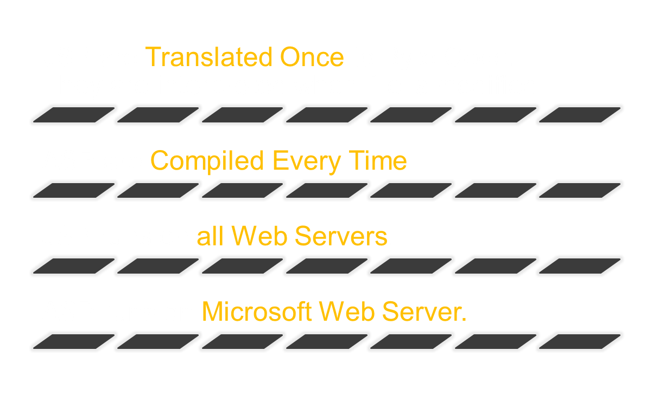

Slide 7

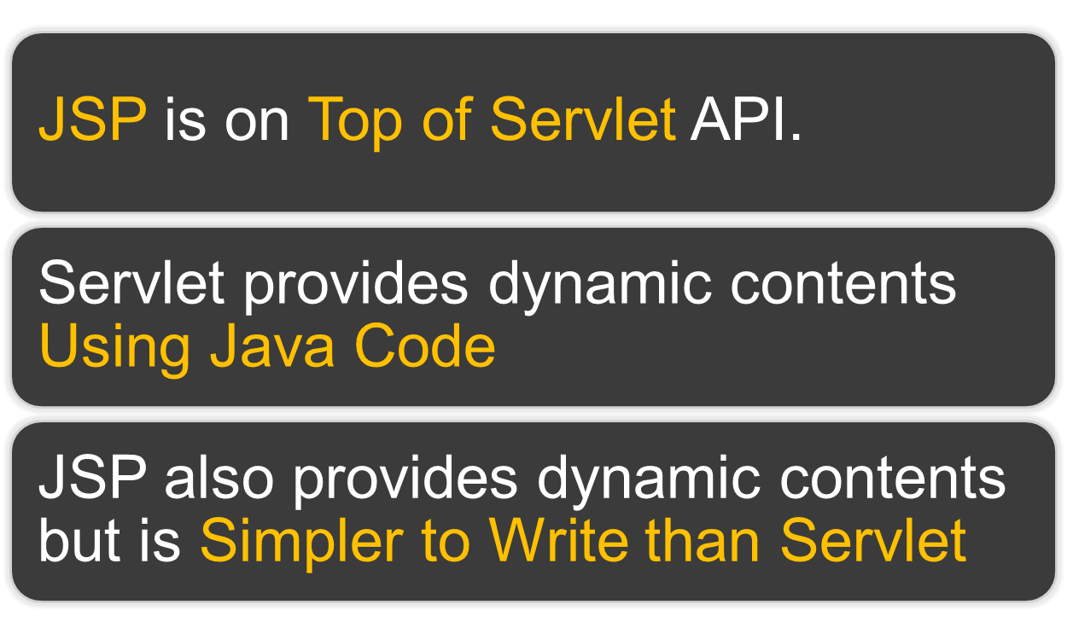

Slide 8

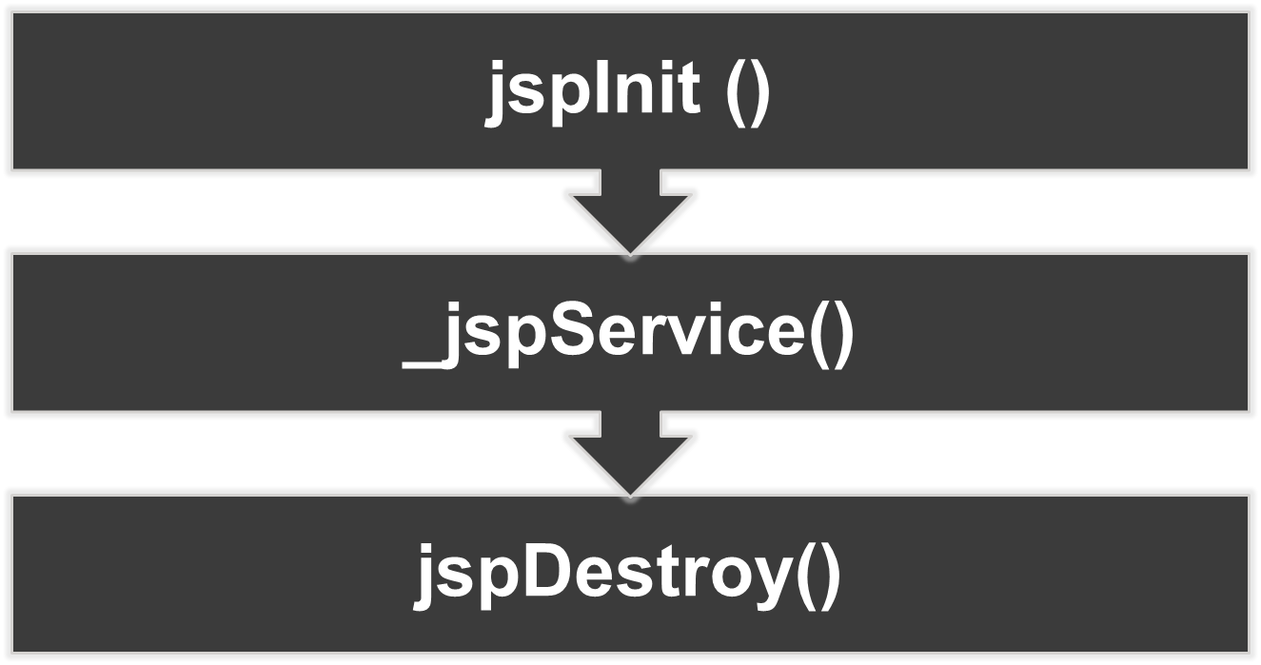

Slide 9

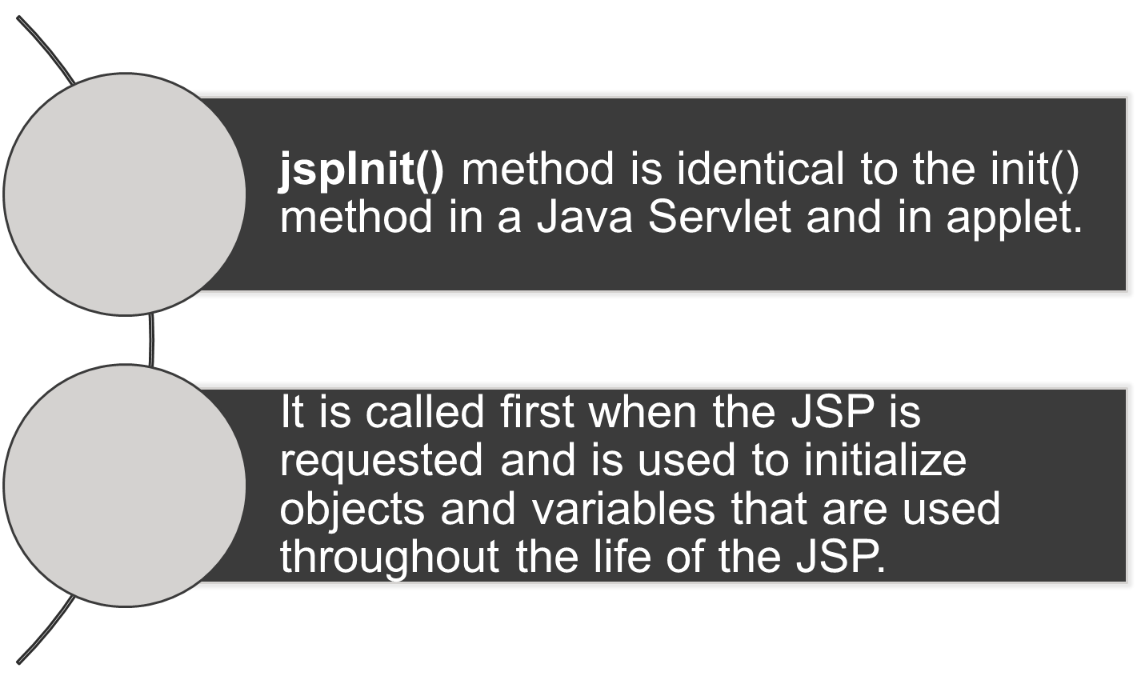

Slide 10

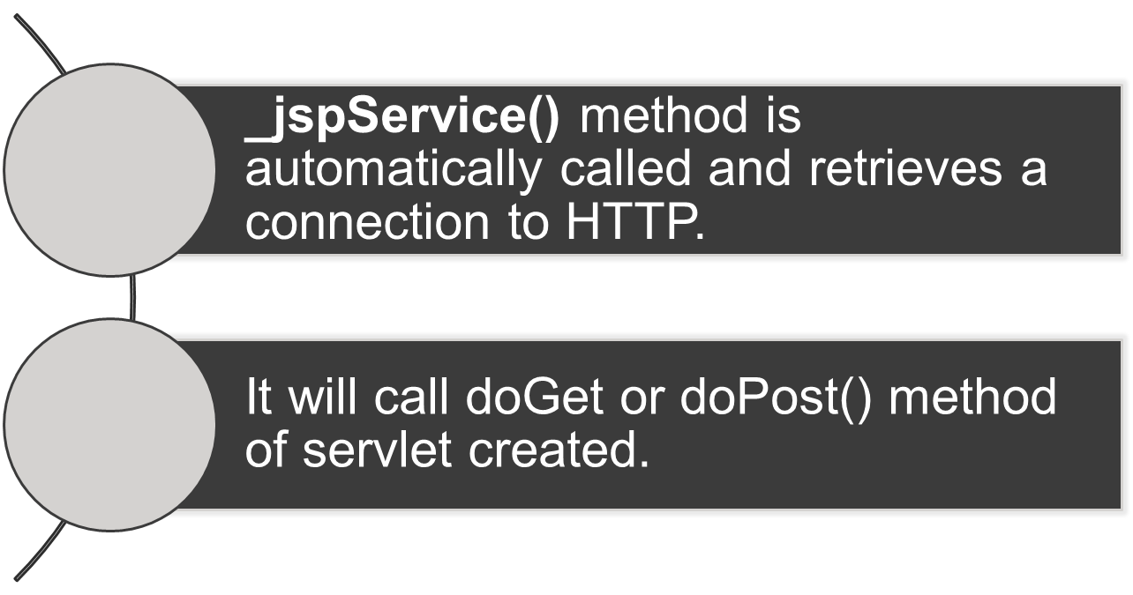

Slide 11

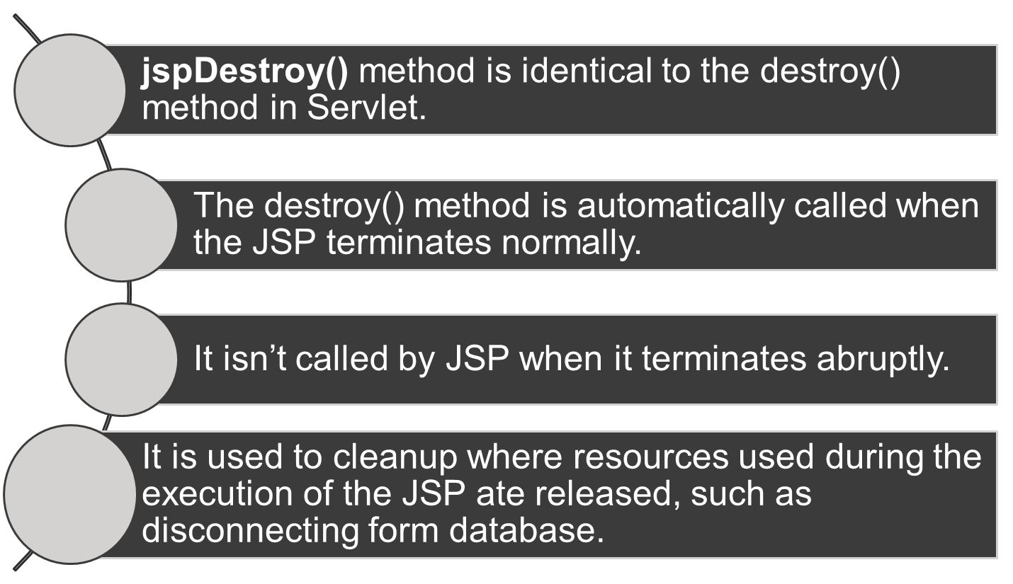

Slide 12
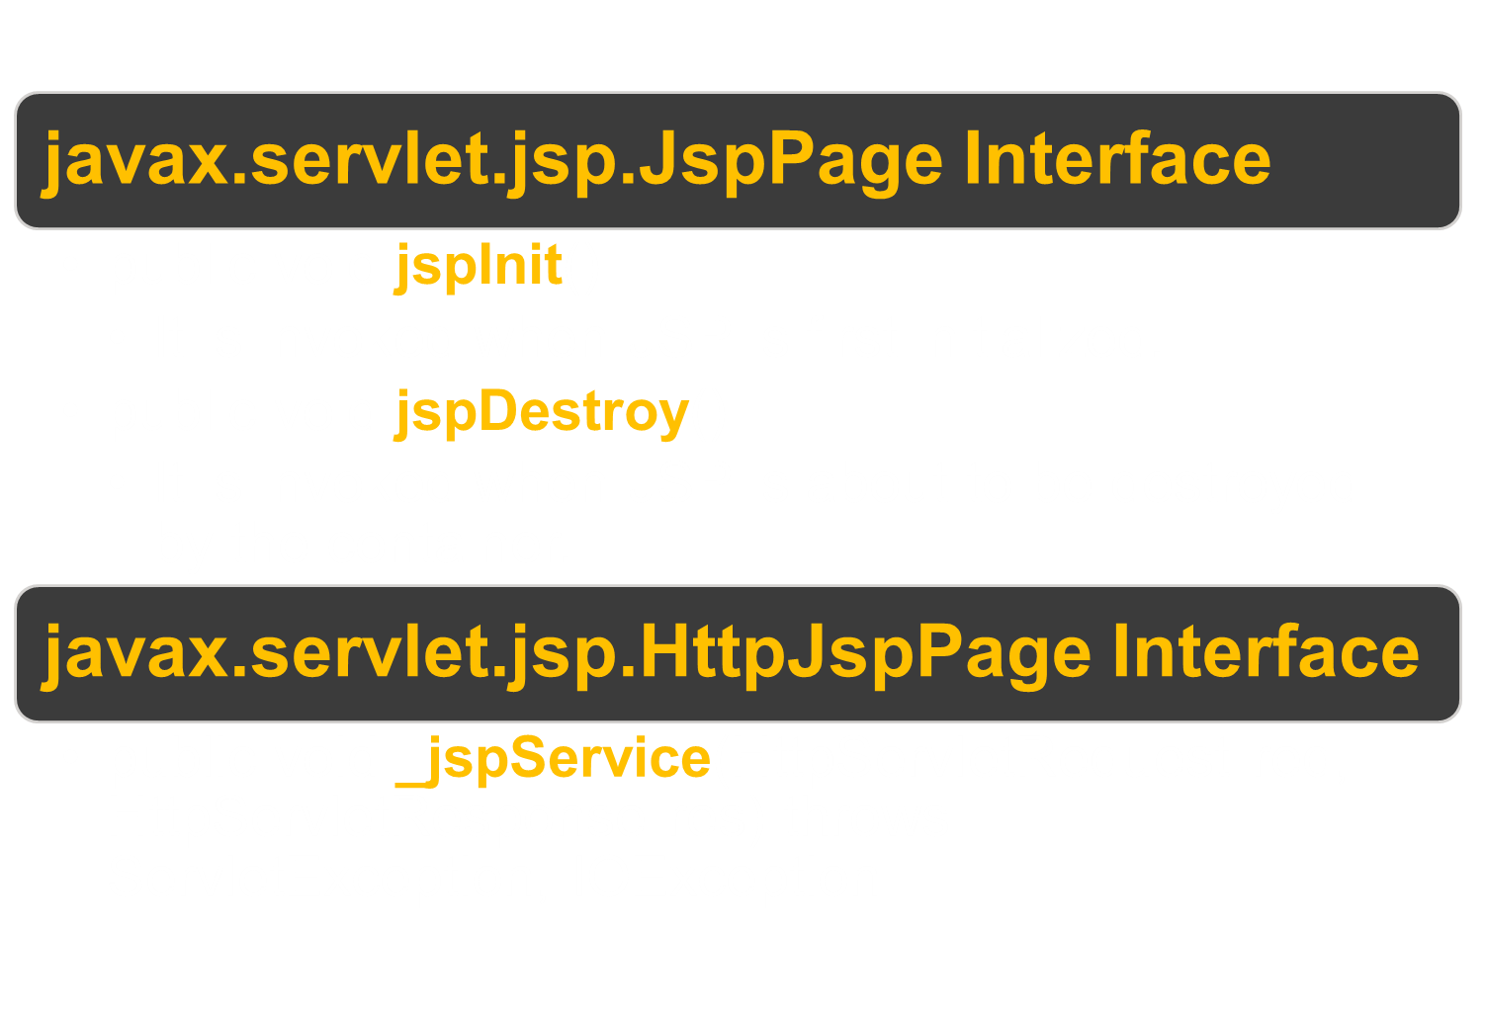

Slide 13

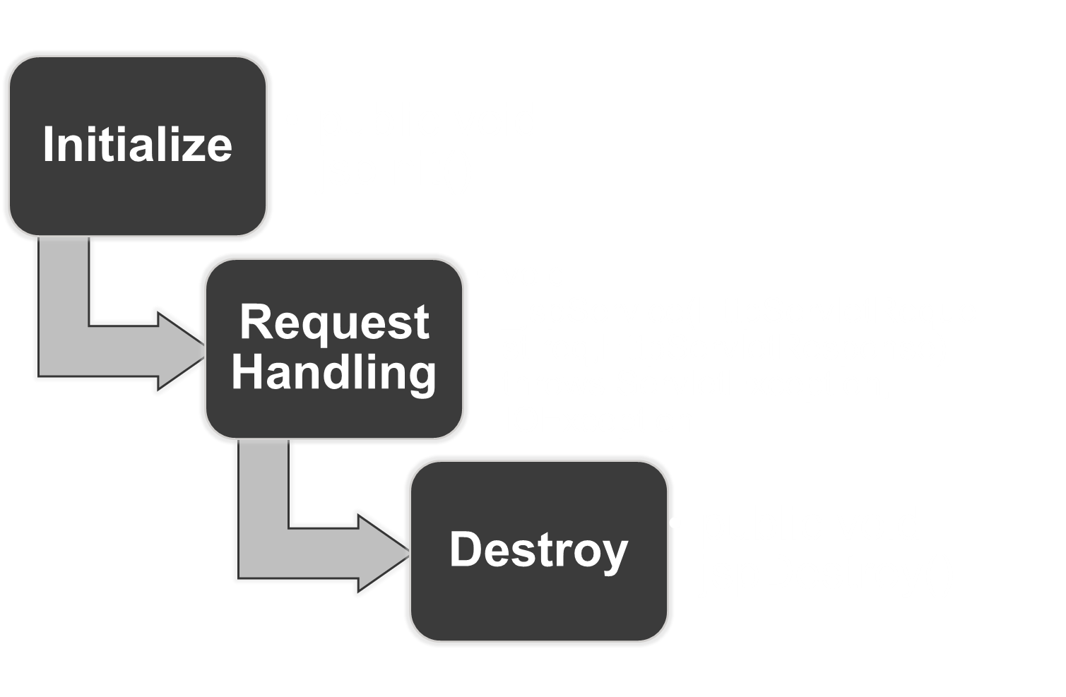

Slide 14

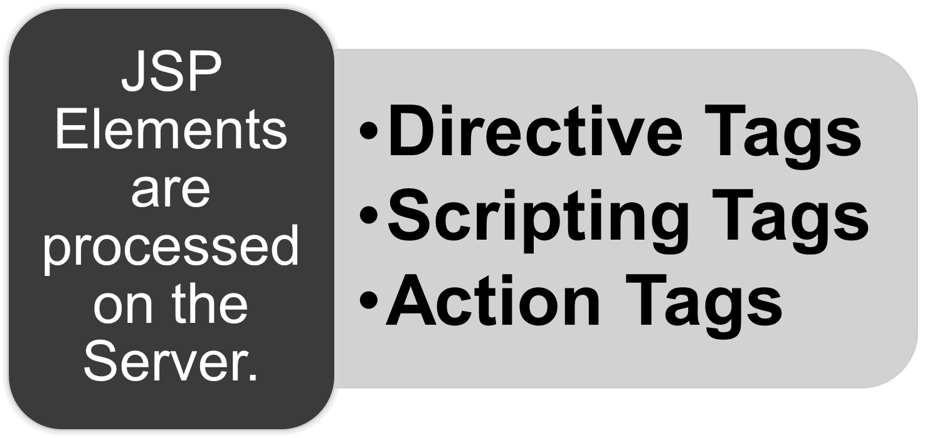

Slide 15


Slide 16
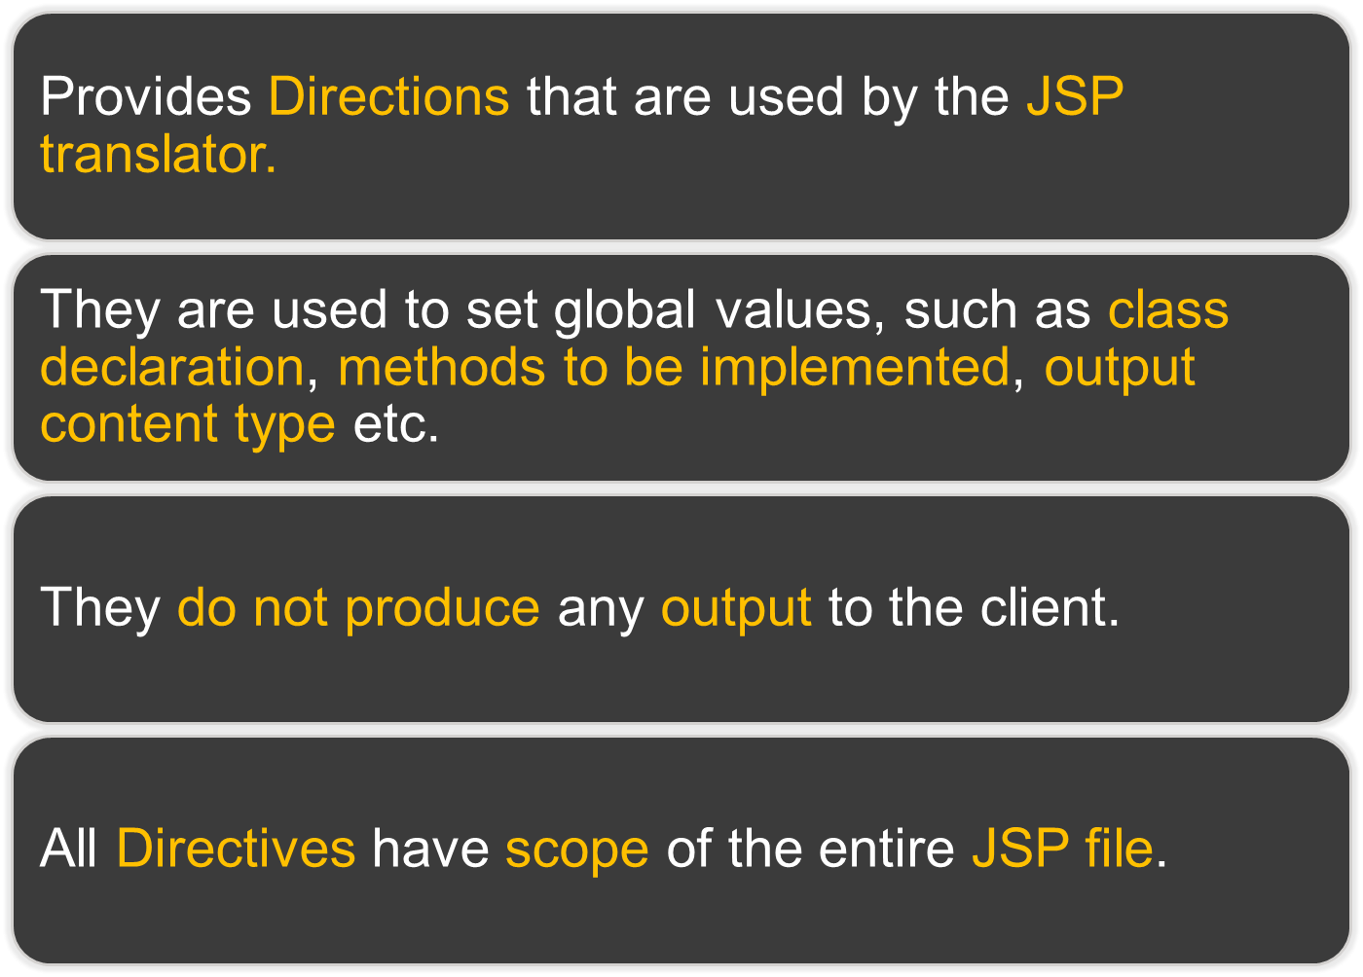

Slide 17

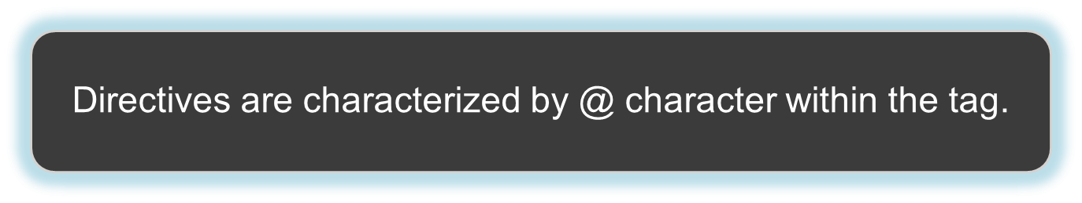

<%@directivename
attribute=“value”
attribute=“value”
%>

Slide 18


@page
@taglib
@include

Slide 19
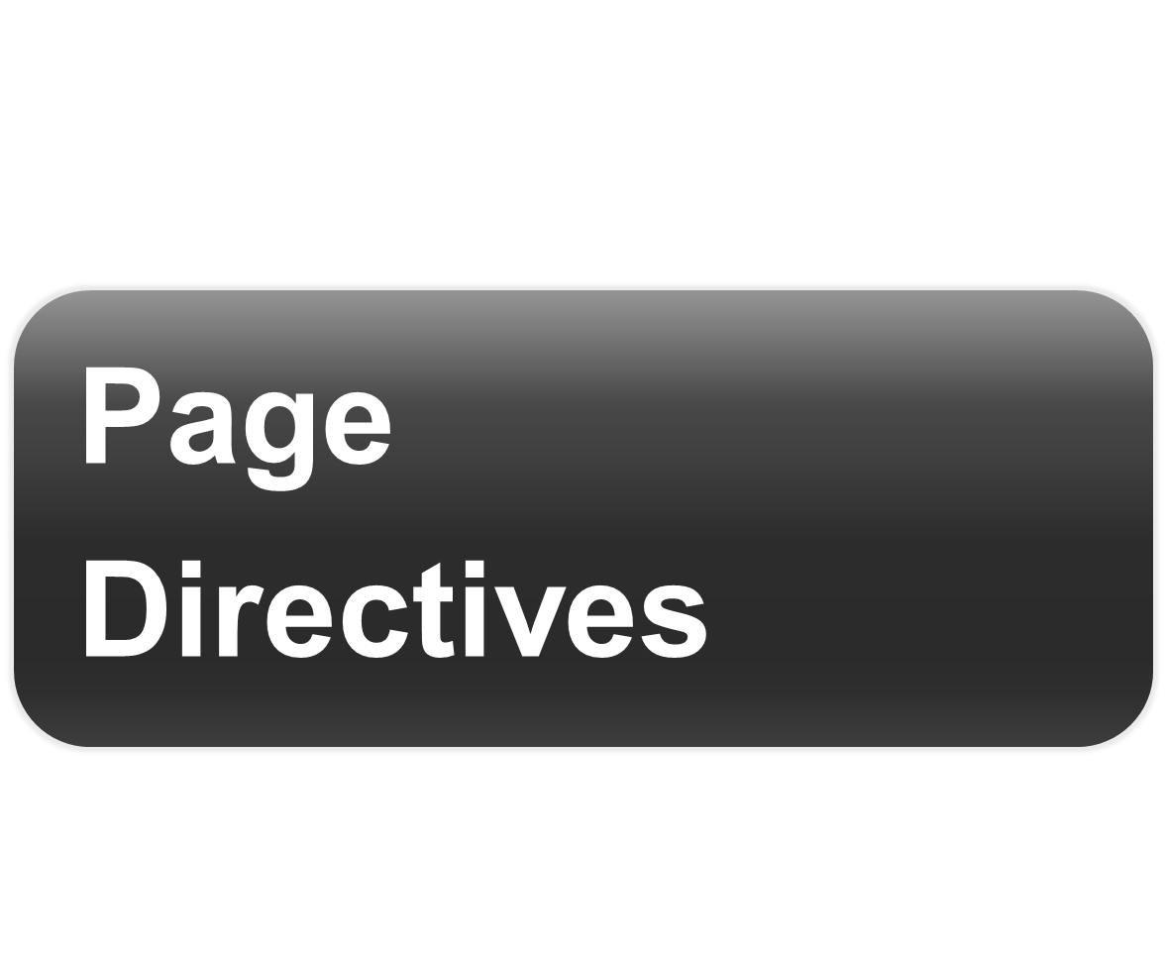

Slide 20

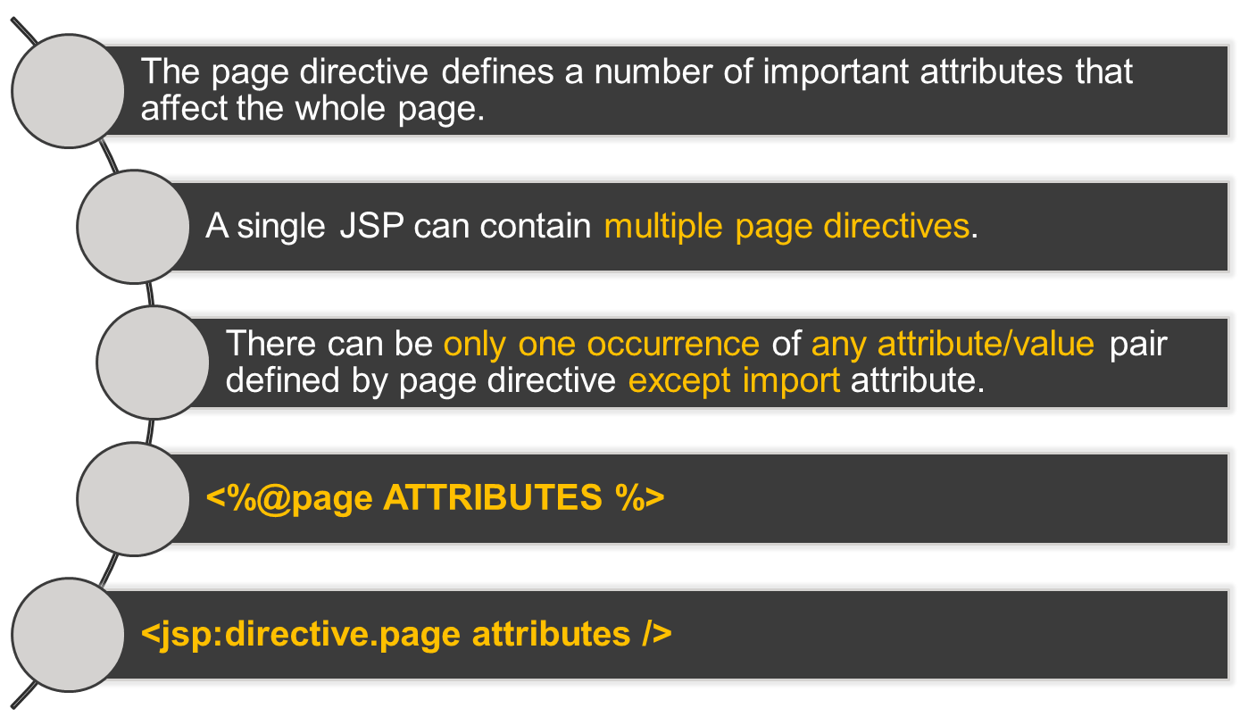

Slide 21

Attribute | Description | Default
language | Defines the scripting language to be used. | “java”
import | Comma separated list of packages or classes. | -
extends | It is fully qualified class name of super class that the generated class must extend | -
buffer | Takes the buffer size in kilobyte. The values of this attribute are none, 8kb, 16kb 32kb and 64kb. | 8kb
session | Specifies if the page participated in an HTTP session. If value set to “false”, the implicit object session can not be used. | “true”
Notes:
‹#›

Slide 22
Page directive Attributes Cont.
Attribute | Description | Default
autoFlush | If true, buffer is flushed automatically when it is full If false, a runtime exception is thrown to indicate buffer overflow. | “true”
isThreadSafe | If “false”, it processes them one at a time implementing singleThreadModel interface | “true”
info | A String which can be retrieved by using getServletInfo() method. | -
isErrorPage | If “true”, then implicit object exception is available which is instance of class java.lang.Throwable | “false”
errorPage | Define a URL to another JSP that is invoked if an unchecked runtime exception is thrown omitted | -
contentType | Define MIME type for the response of the JSP page. | text/html
pageEncoding | Specifies the encoding type to be used by a Web Container to compile a JSP. (ISO-8859-1, UTF-8, etc…) | -

Slide 23

<%@page language=”java” import=”java.sql.*” buffer=”16kb” errorPage=”error.jsp” %>
<jsp:directive.page session=“false” import=“java.util.*” import=“java.sql.*” isErrorPage=“true” />

Slide 24
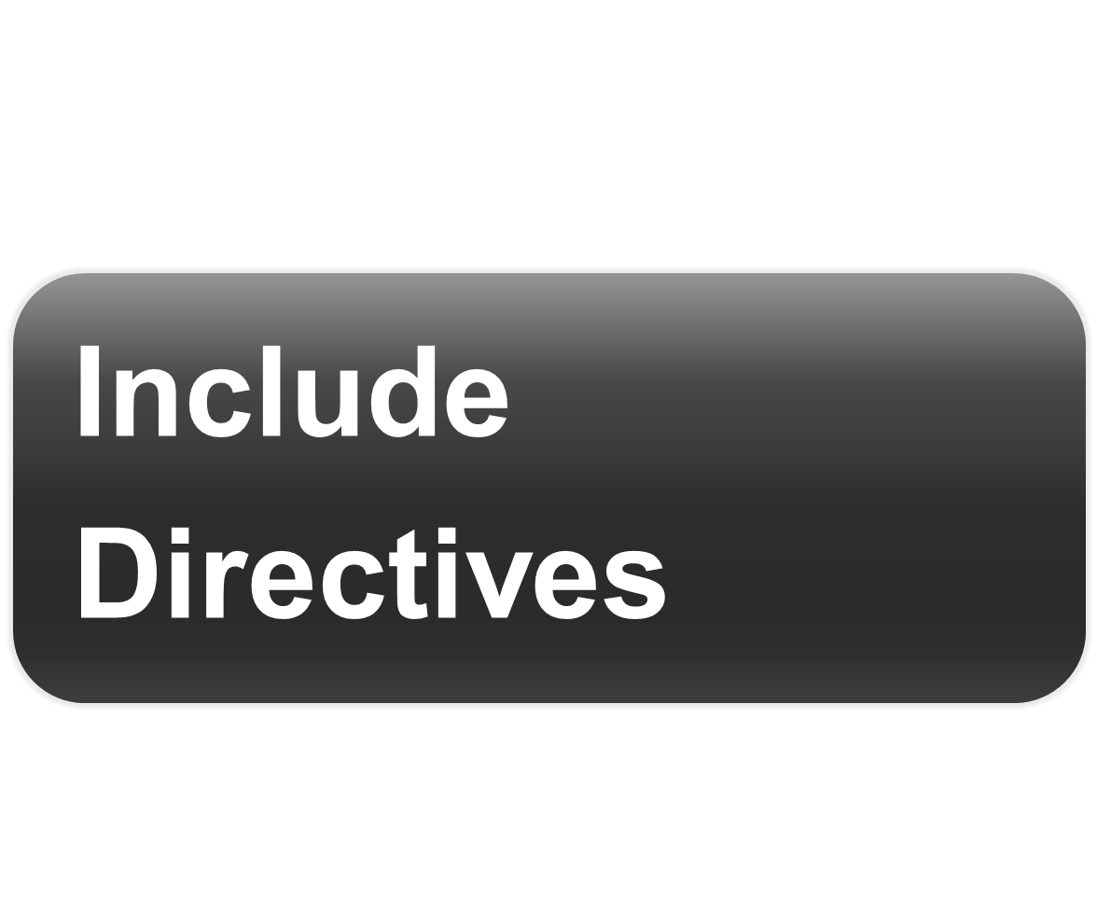

Slide 25

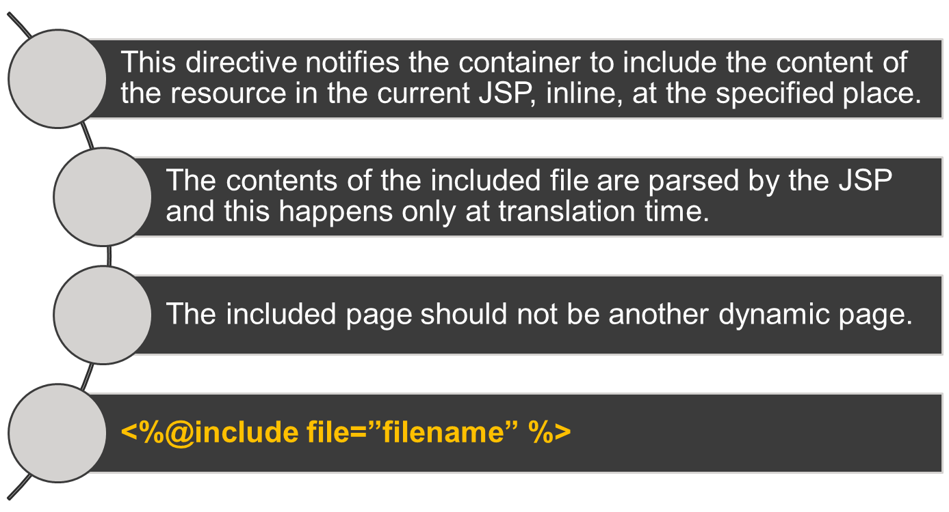

Slide 26


Attribute | Description
File | The Static Filename to include
<%@ include file=”header.html” %>
<%@ include file=”footer.html” %>

Slide 27
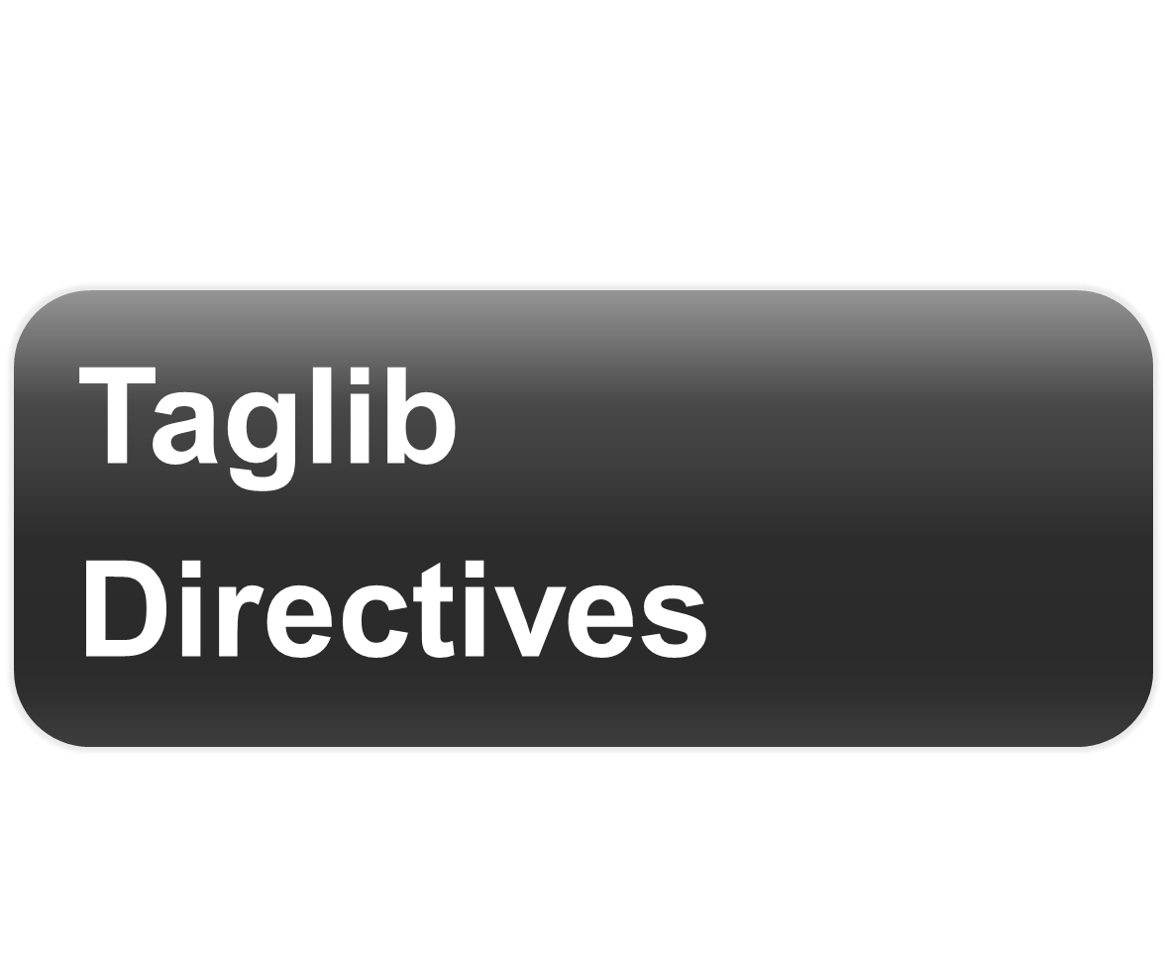

Slide 28

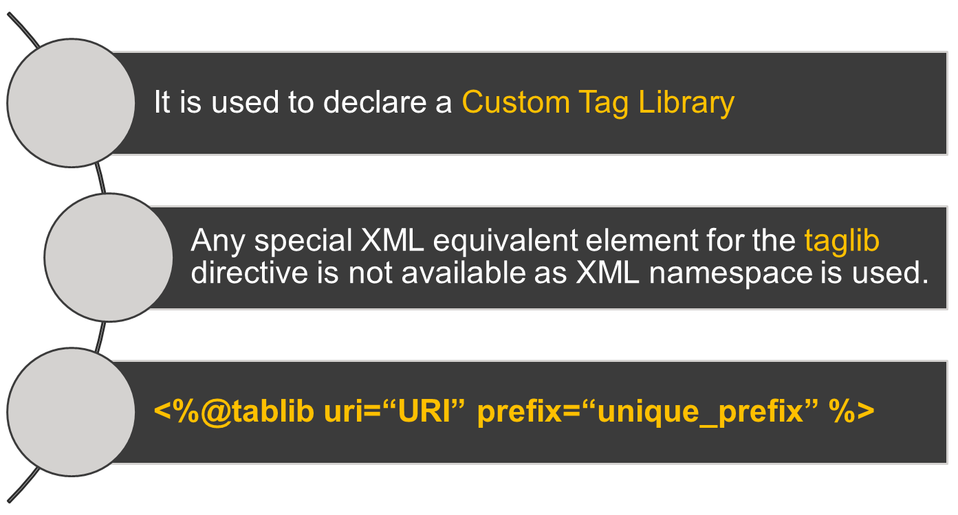

Slide 29


Attribute | Description
uri | Universal Resource Identifier(Location) for the Tag Library to be used.
Prefix | A prefix to be given for the specific library.
<%@taglib prefix=“myTags”
uri=”http://spkm.com/jsp/myTagLibrary” %>

Slide 30


Slide 31

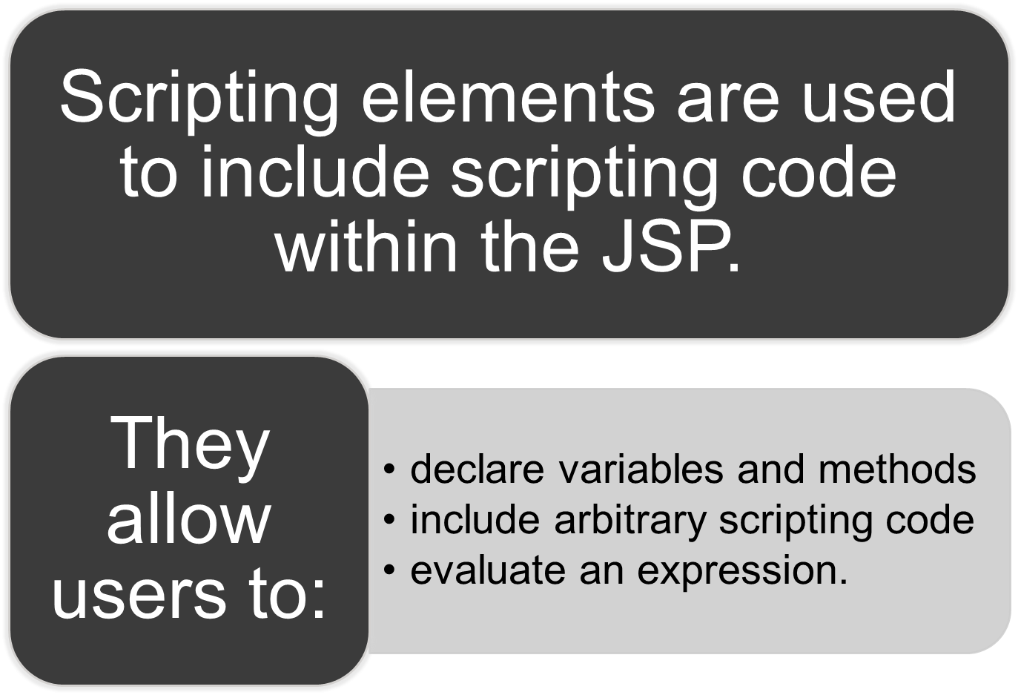

Slide 32

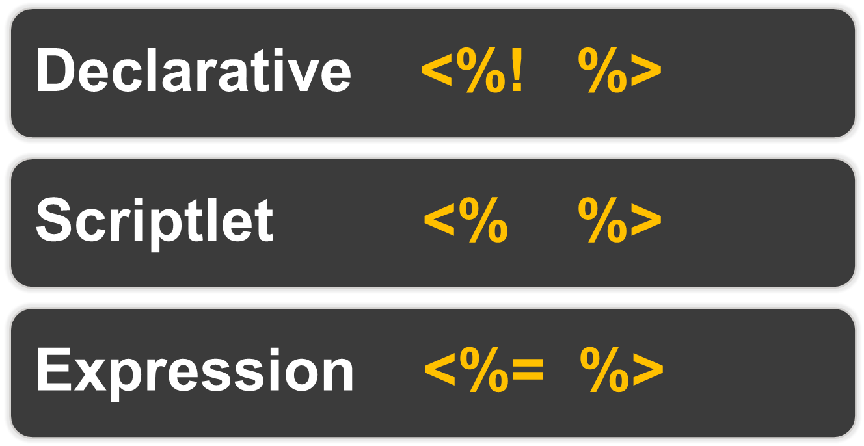

Slide 33
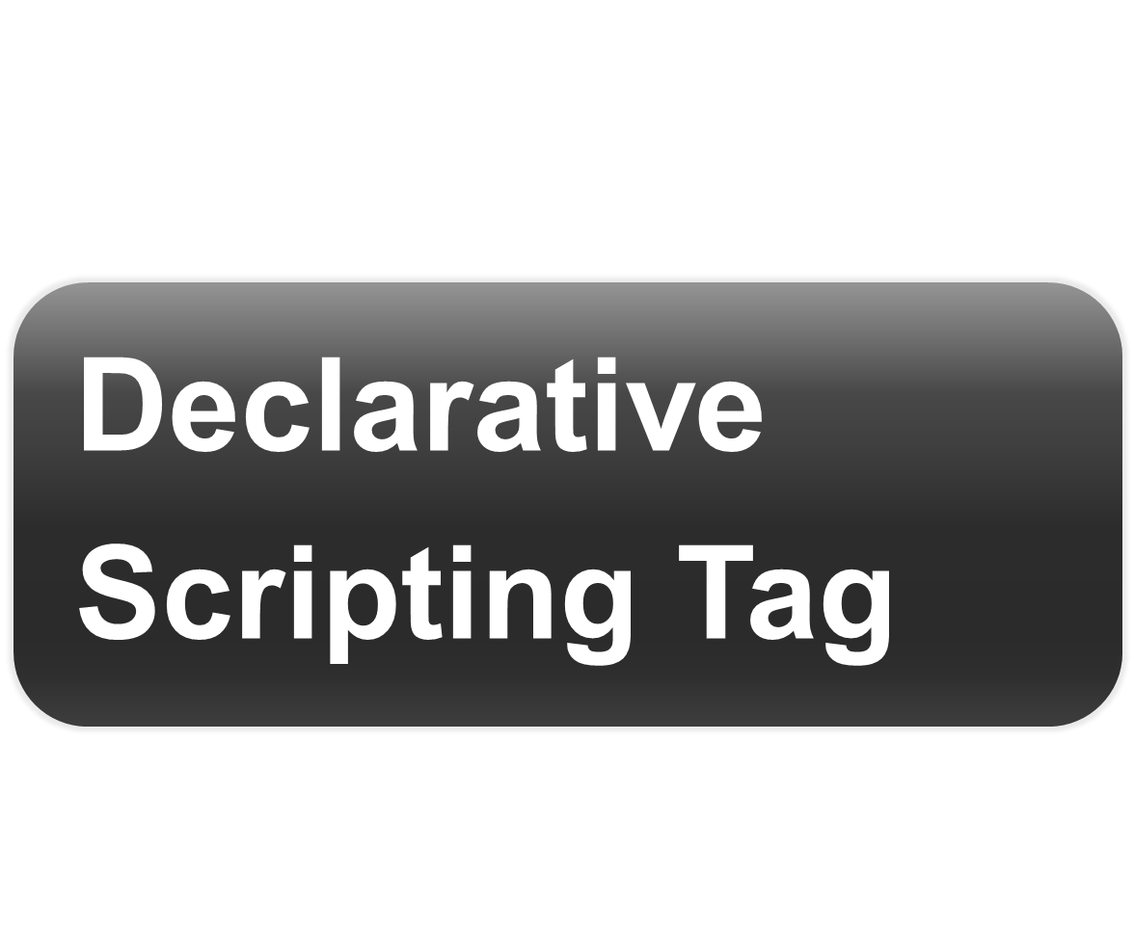

Slide 34
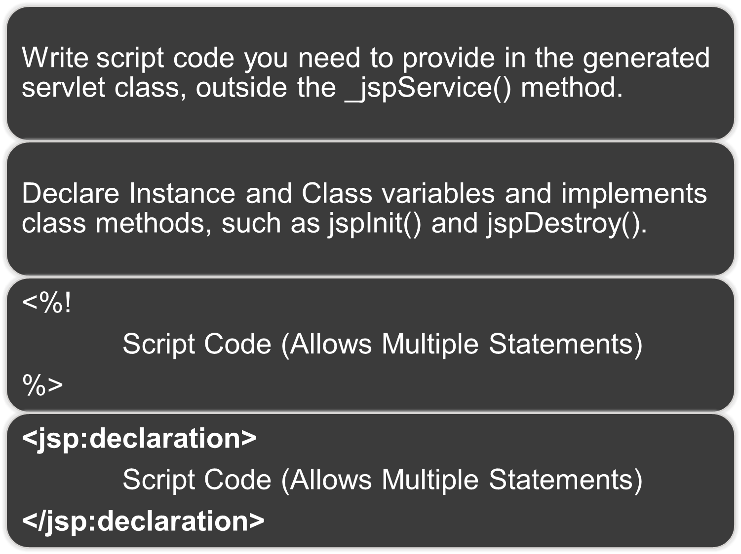

Slide 35
<html>
<body>
<%! int i=0;
int myMethod(){
return i; }
%>
</body>
</html>

Slide 36
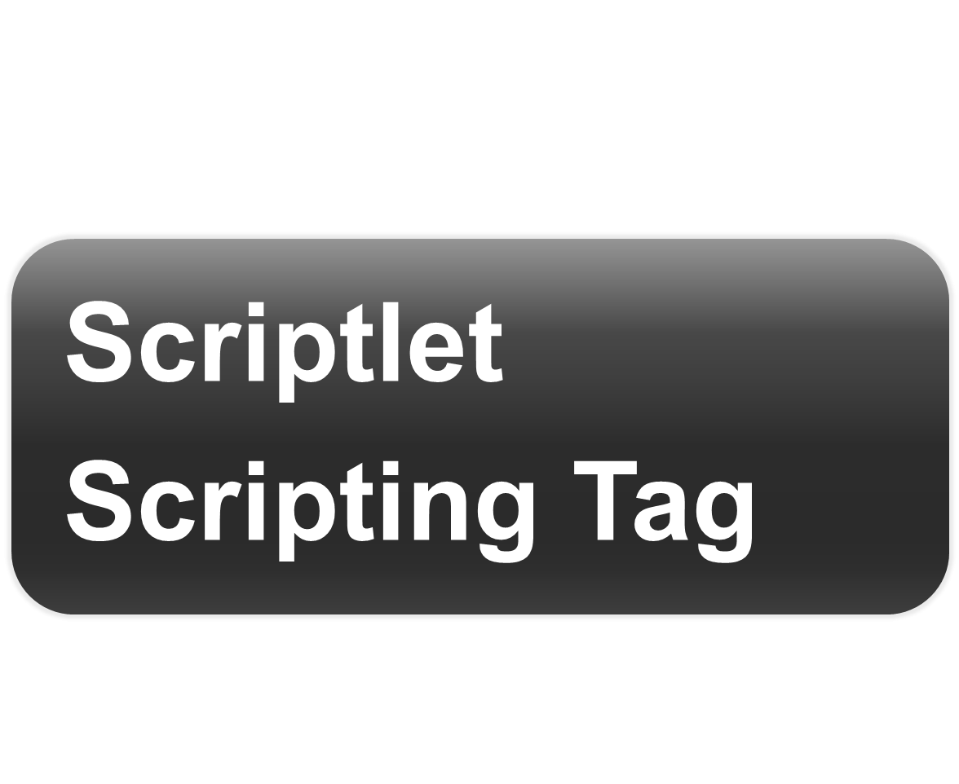

Slide 37
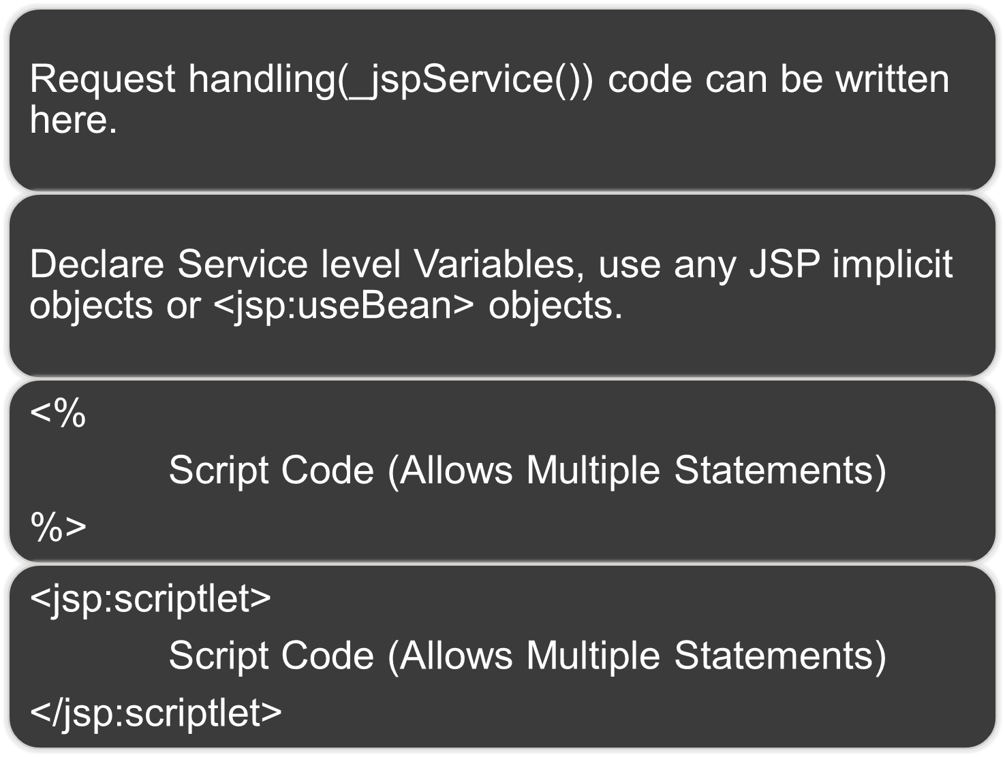

Slide 38
<html>
<body>
<%
for(int i=0;i<10;i++){
out.println(“<b> Hello” +
i +”</b>”);
}
%>
</body>
</html>

Slide 39
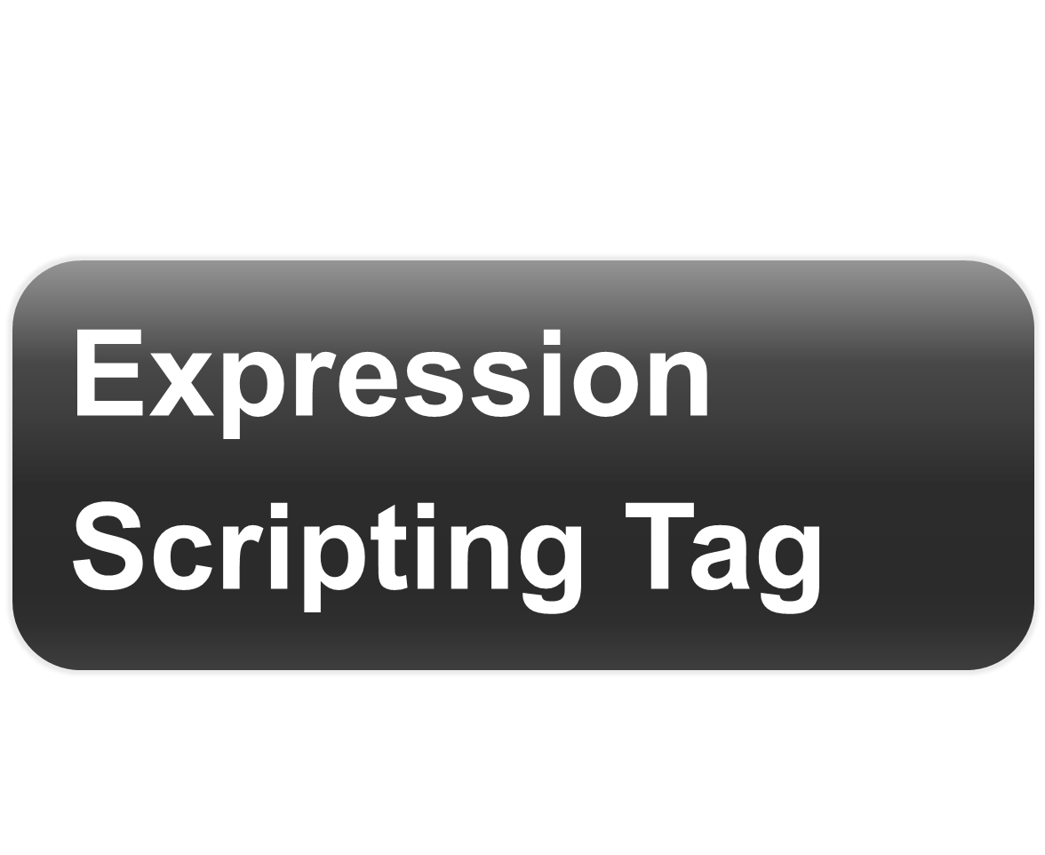

Slide 40
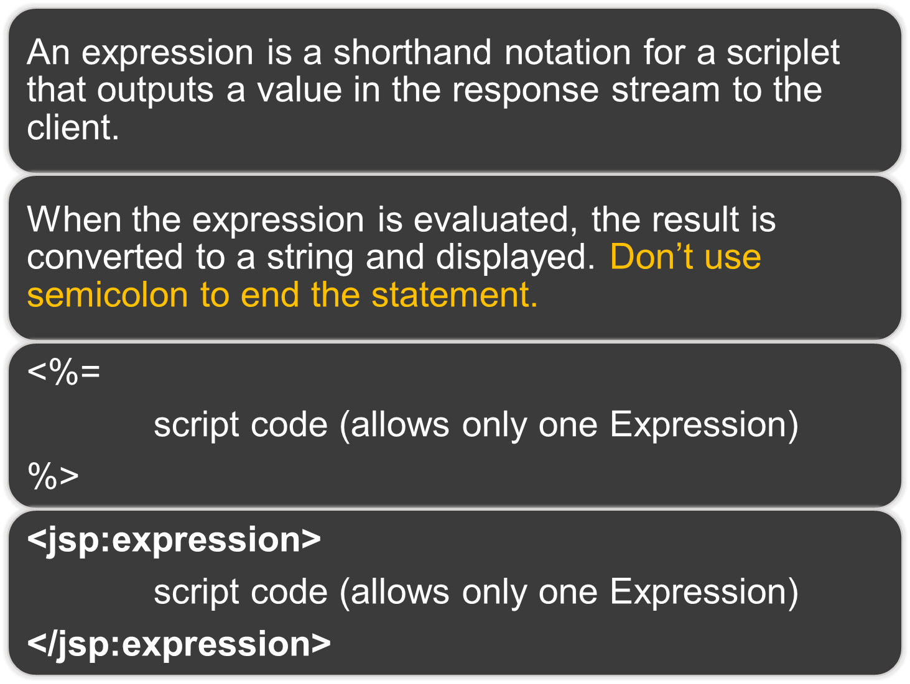

Slide 41
<html>
<body>
<%! int count; %>
<% count++; %>
This page is accessed
<%=count %> + times.
</body>
</html>

Slide 42



Slide 43



Slide 44
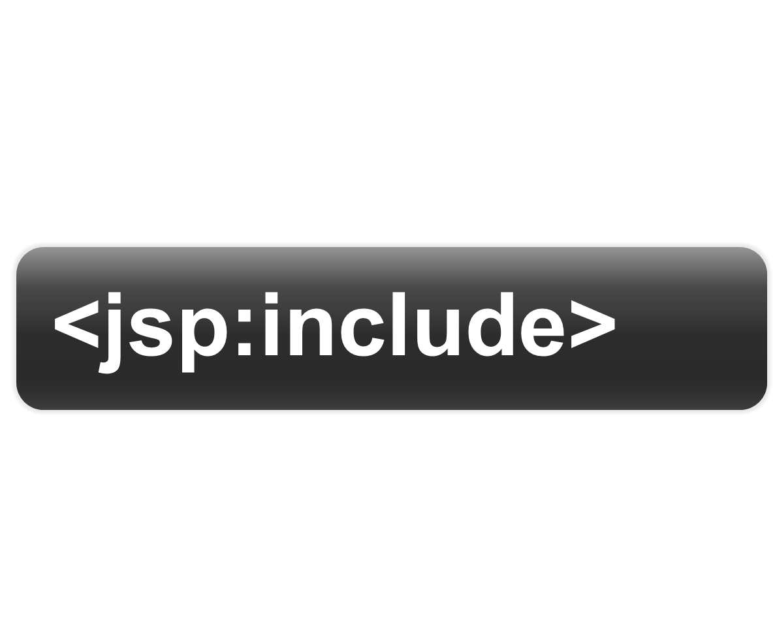

Slide 45
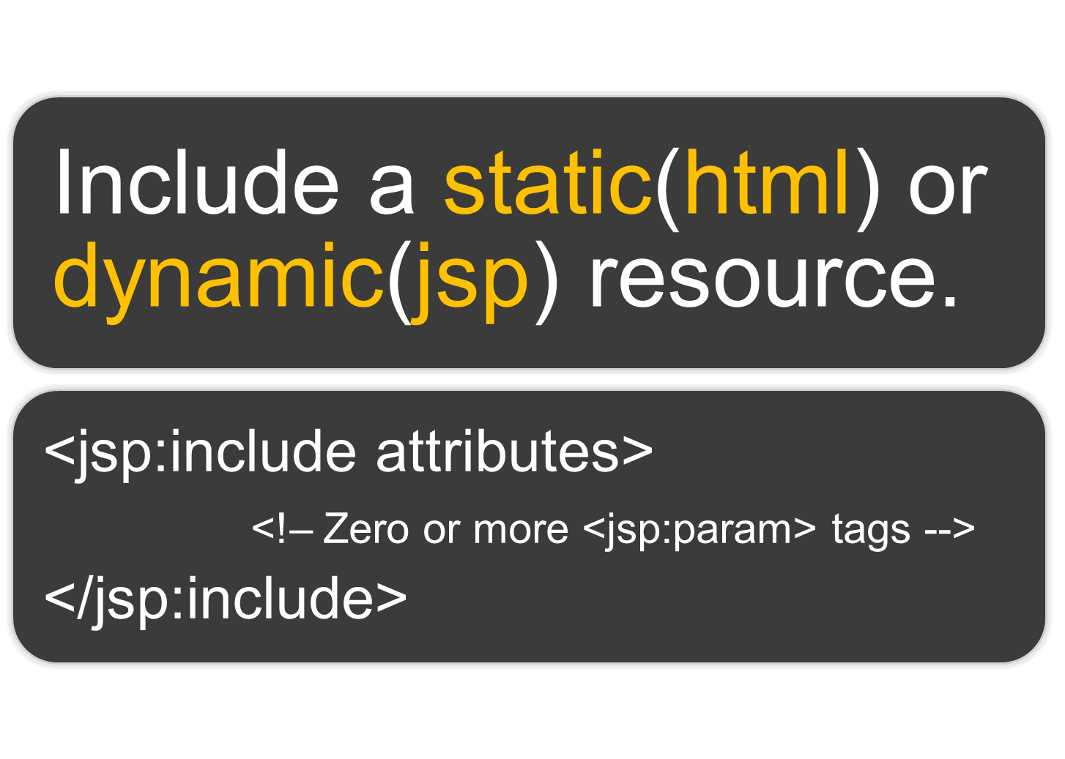

Slide 46

Attribute | Description | Default
page | A relative URL, which specifies the location of the resource to be included. Expression can be used. | -
flush | true/false value can be set. if true, buffer is flushed before including the resource. | false
Notes:
‹#›

Slide 47
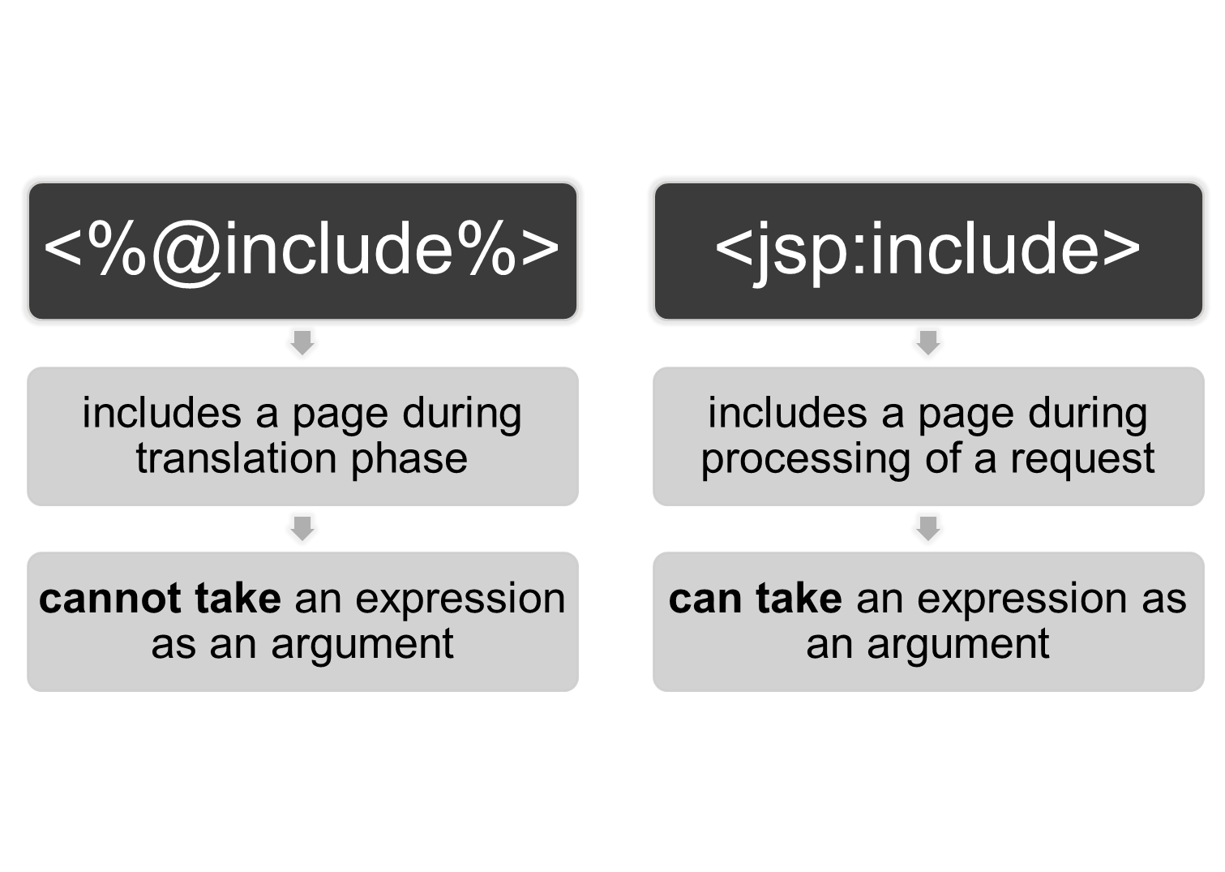

Slide 48
<html>
<body>
The sample text
<jsp:include page=“login.jsp” />
This is footer text
</body>
</html>

Slide 49
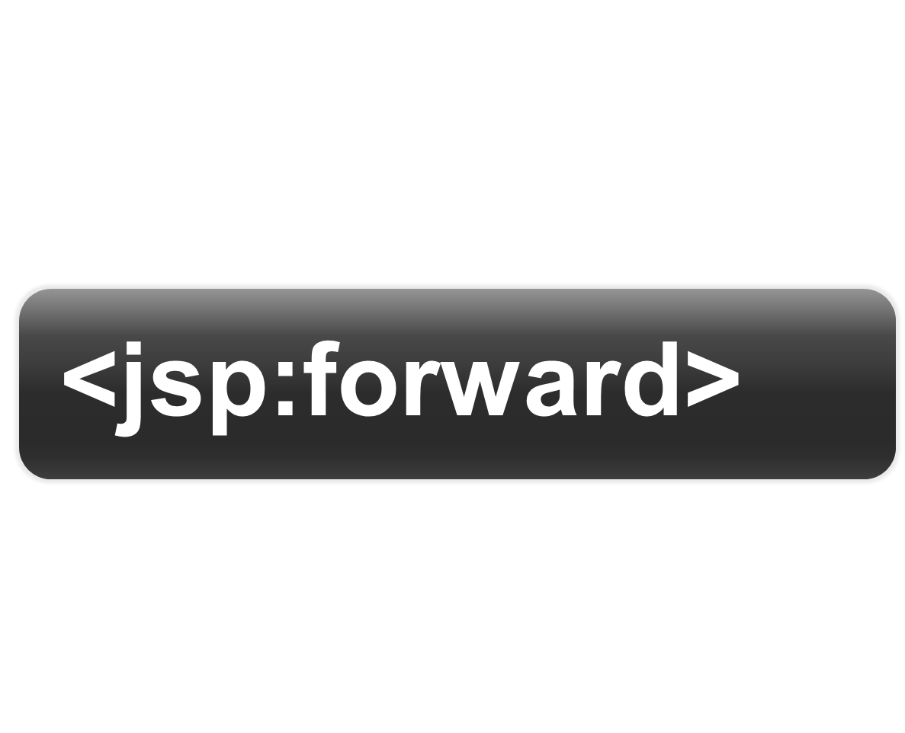

Slide 50
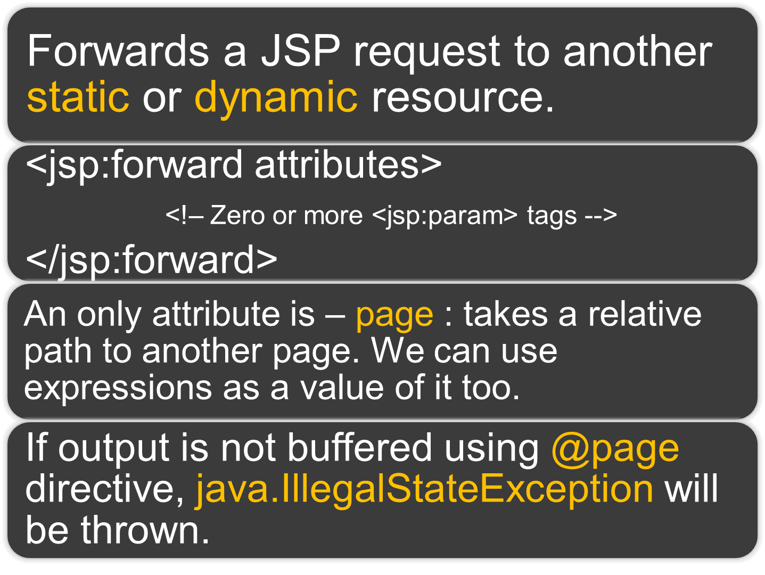

Slide 51
<html>
<body>
The sample text
<jsp:foward page=“login.jsp” />
This is sample text
</body>
</html>

Slide 52
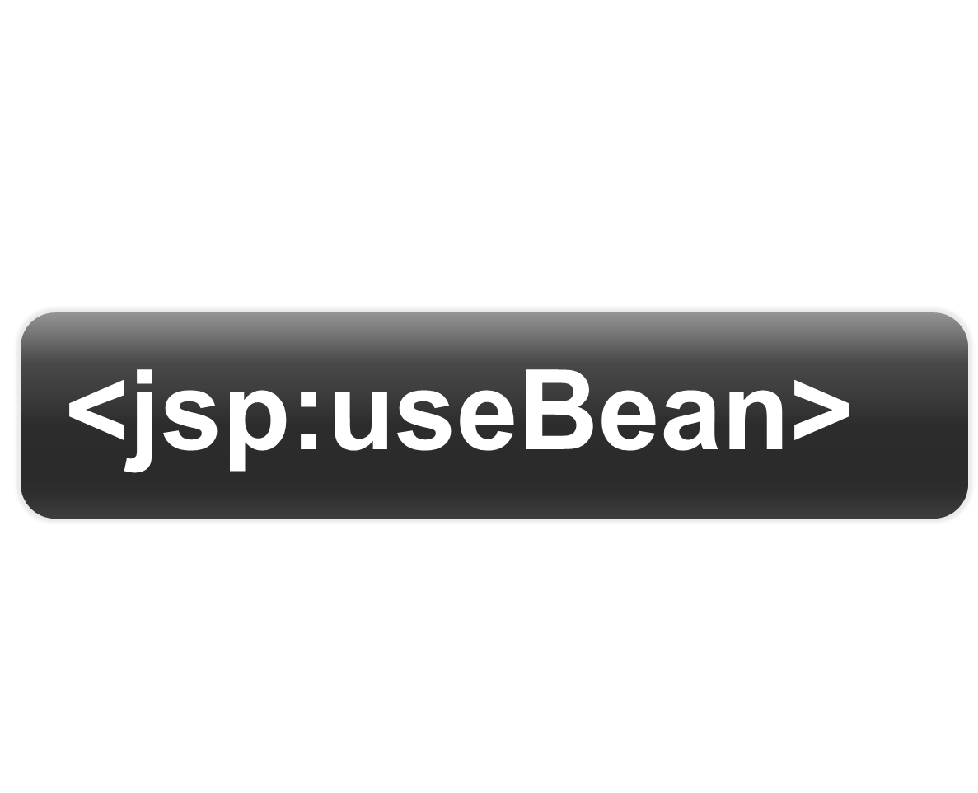

Slide 53
JavaBeans
A bean is just a Java class. You don't need to extend any base class or implement any interface. To be a bean, however, a Java class must follow certain rules specified by the JavaBeans specification. In relation to JavaBeans that can be used from a JSP page, these rules are as in next slides🡪

Slide 54
JavaBeans
The bean class must have a no-argument constructor. In the bean the class may not have a constructor at all. This still is legal because the Java compiler will automatically create a no-argument constructor for any Java class that does not have a constructor.

Slide 55
JavaBeans
Optionally, a bean can have a public method that can be used to set the value of a property. This method is called a setter method. The method does not return any value, and its name starts with "set" followed by the name of the property. A setter method has the following signature:

Slide 56
JavaBeans
public void setPropertyName (PropertyType value); For example, the setter method for the property operand must be named setOperand. Note that the spelling for the property name is not exactly the same. A property name starts with a lowercase letter, but the name of the setter uses an uppercase letter after "set"; hence setOperand.

Slide 57
JavaBeans
Optionally, a bean can have a public method that can be called to obtain the value of a property. This method is called a getter method, and its return type is the same as the property type. Its name must begin with "get"; followed by the name of the property. A getter method has the following signature:

Slide 58
JavaBeans
public PropertyType getPropertyName(); As an example, the getter method for the property named operand is getOperand. A property name starts with a lowercase letter, but the name of the getter uses an uppercase letter after "get;" hence getOperand.

Slide 59
JavaBeans
Both setter and getter methods are known as access methods. In JSP, the jsp:getProperty and jsp:setProperty action elements are used to invoke a getter and a setter method, respectively. You can call these methods the same way you call an ordinary method, however.

Slide 60

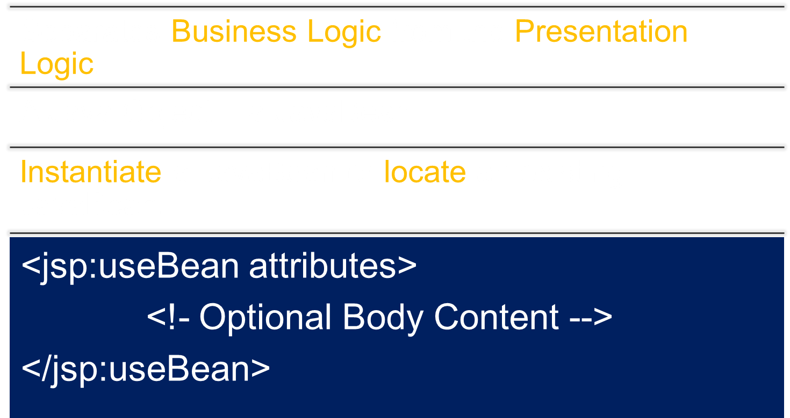

Slide 61




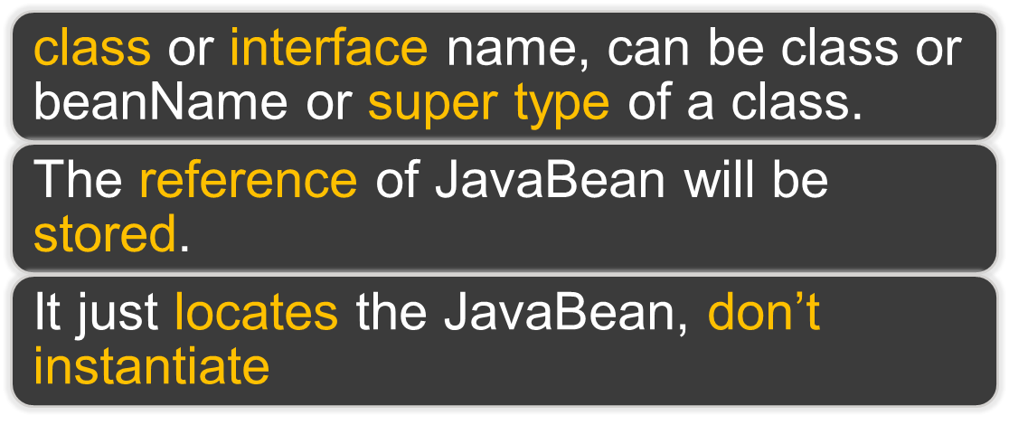
A Variable to access JavaBean
In which scope the created Bean should be accessible.

Slide 62


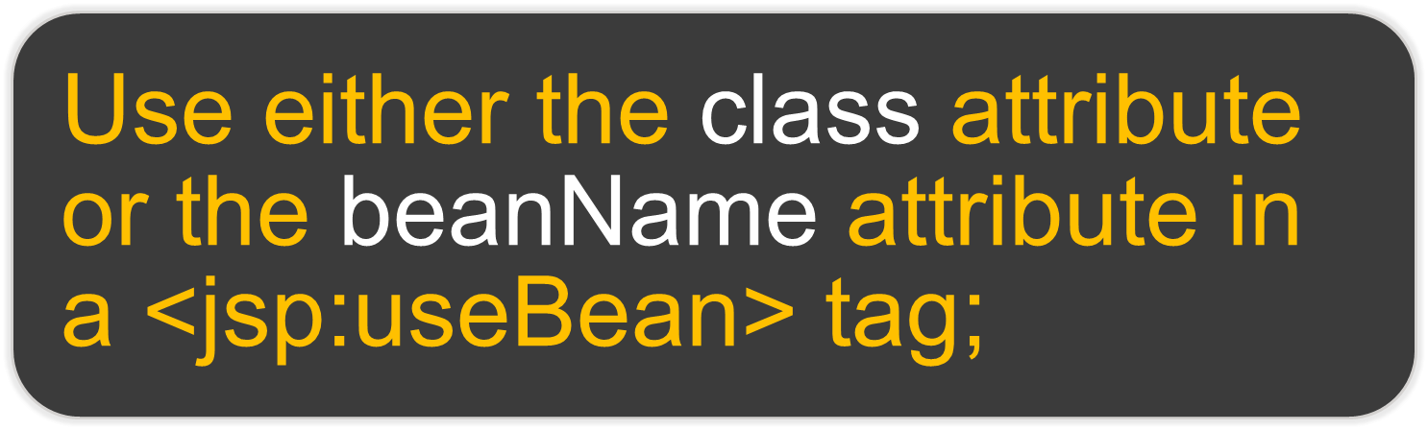
  Creates a JavaBean, if not found in current scope
  should not be Abstract
  Calls no-argument constructor to create a JavaBean instance using new
  Class name cannot be given dynamically
  Class name or expression.
  Calls instantiate method defined in java.beans.Beans class.
  If serialized template is found, instantiate method reads using class loader and instantiates.
  If serialized template is not found, Calls no-argument constructor to create an instance.
  Class name can be given dynamically
Notes:
‹#›

Slide 63
<jsp:useBean id=“myBean”>
<jsp:attribute name=“class” trim=“true” > pkg.RegForm </jsp:attribute>
<jsp:attribute name=“scope” > session </jsp:attribute>
<jsp:body>
<jsp:setProperty name=“myBean” property=“*” />
</jsp:body>
</jsp:useBean>

Slide 64
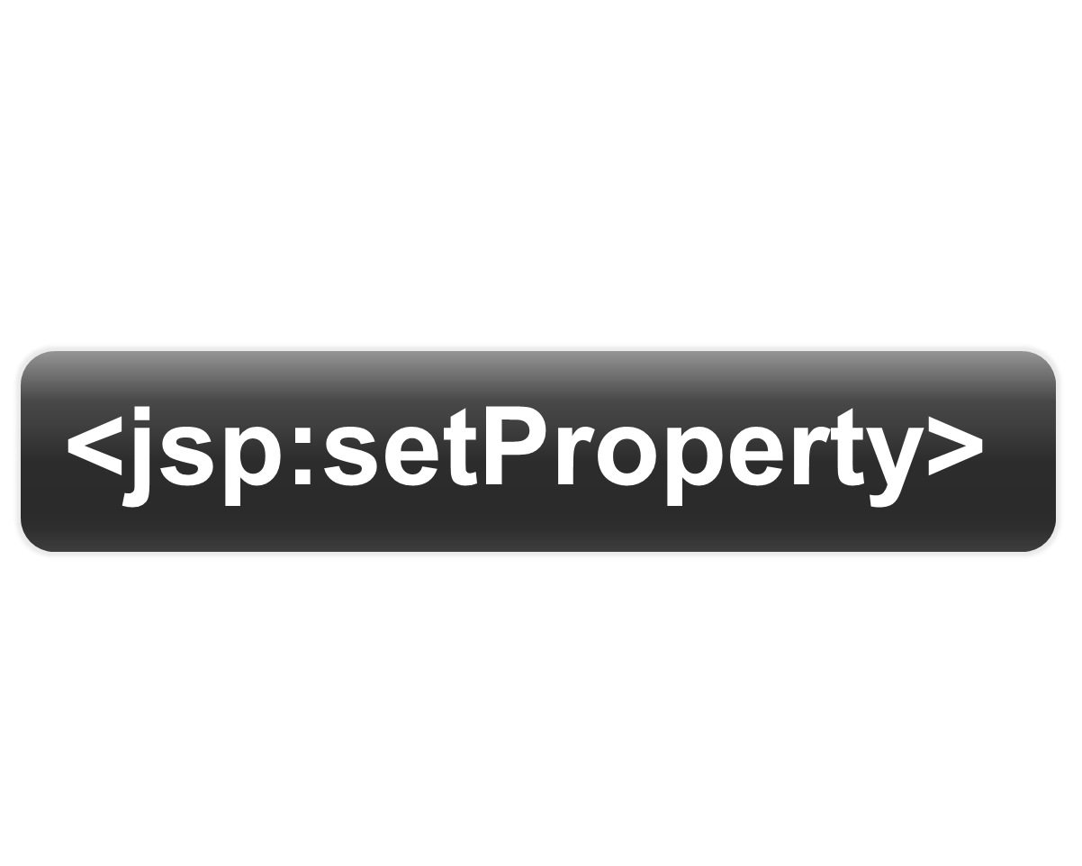

Slide 65
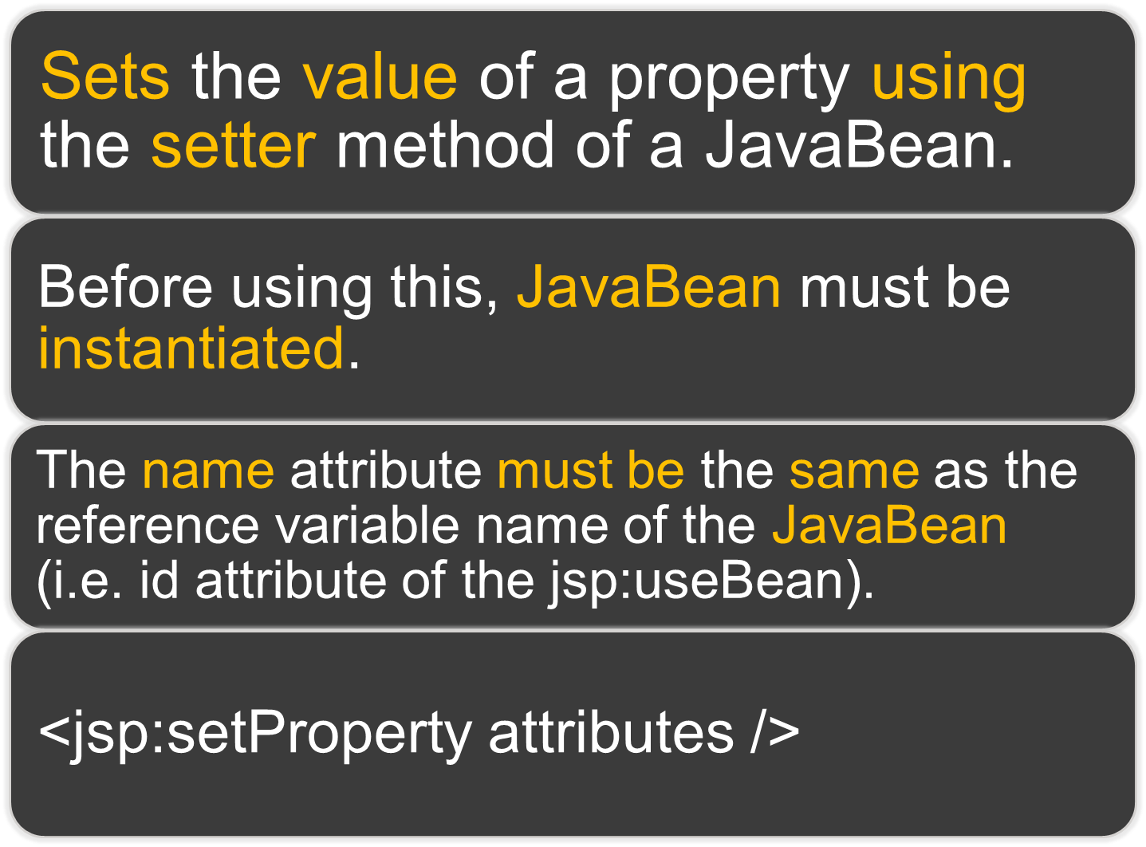

Slide 66

Attribute | Description
name | The name of an existing JavaBean as a reference variable to invoke a setter method. Value must match the id attribute of <jsp:useBean> to set the property of a bean.
property | Property name to be set, two methods to set it. - Use an * (asterisk) sign as a value, which matches all properties of JavaBean with the request parameter names. - Use a property name, that you have created in your bean file.
value | A specific value to be set to the named property. We may provide Expression. Can’t use when property value is *.
param | Specifies request parameter name whose value is to be assigned to property. Can’t use when property value is *.
OR
Notes:
‹#›

Slide 67
<jsp:useBean id=“myBean” class=“pkg.RegForm” scope=“session” />
<jsp:setProperty name=“myBean” property=“firstName” param=“fn” />
<jsp:setProperty name=“myBean” property=“lastName” param=“ln” />
<jsp:setProperty name=“myBean” property=“*” />
OR

Slide 68


Slide 69
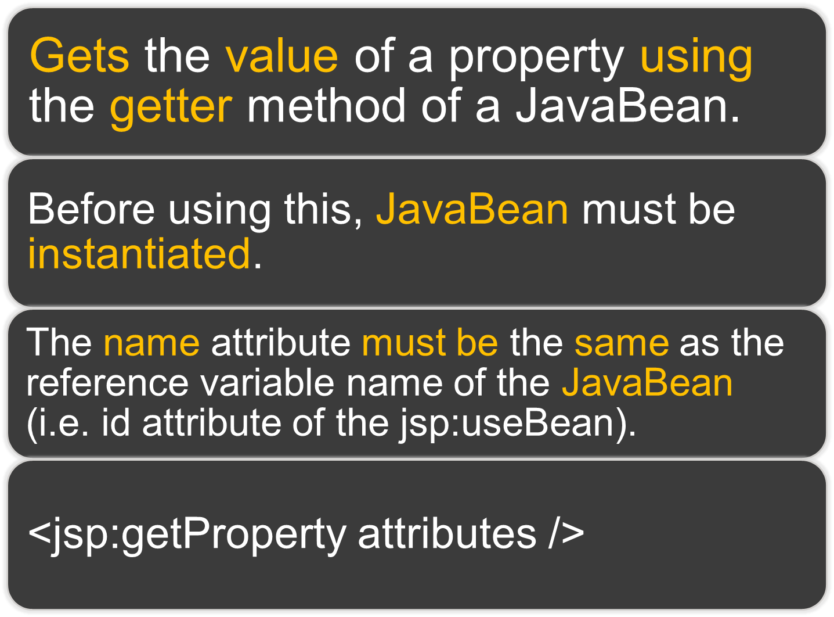

Slide 70

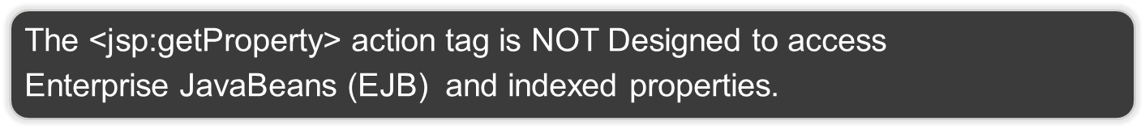
Attribute | Description
name | The name of an existing JavaBean as a reference variable to invoke a getter method. Value must match the id attribute of <jsp:useBean> to get the property of a bean.
property | Property name to get the value of. Use a property name, that you have created in your bean file.
Note:
Notes:
‹#›

Slide 71
<jsp:useBean id=“myBean” class=“pkg.RegForm” scope=“session” />
First Name : <jsp:getProperty name=“myBean” property=“firstName” />
Last Name : <jsp:getProperty name=“myBean” property=“lastName” />

Slide 72
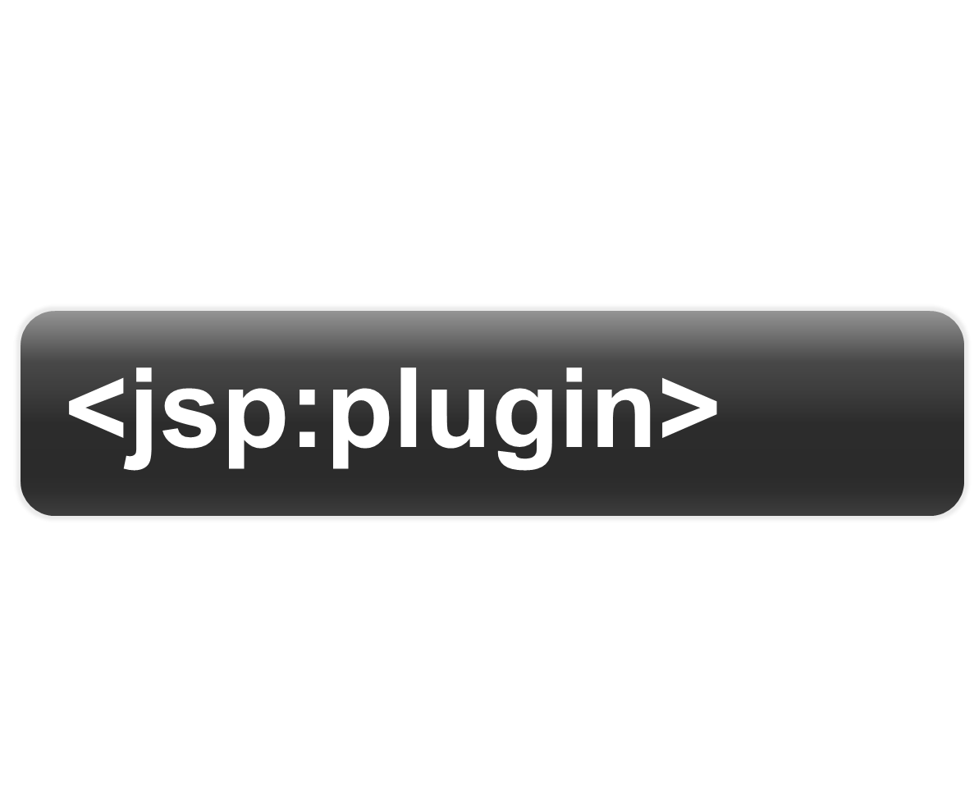

Slide 73
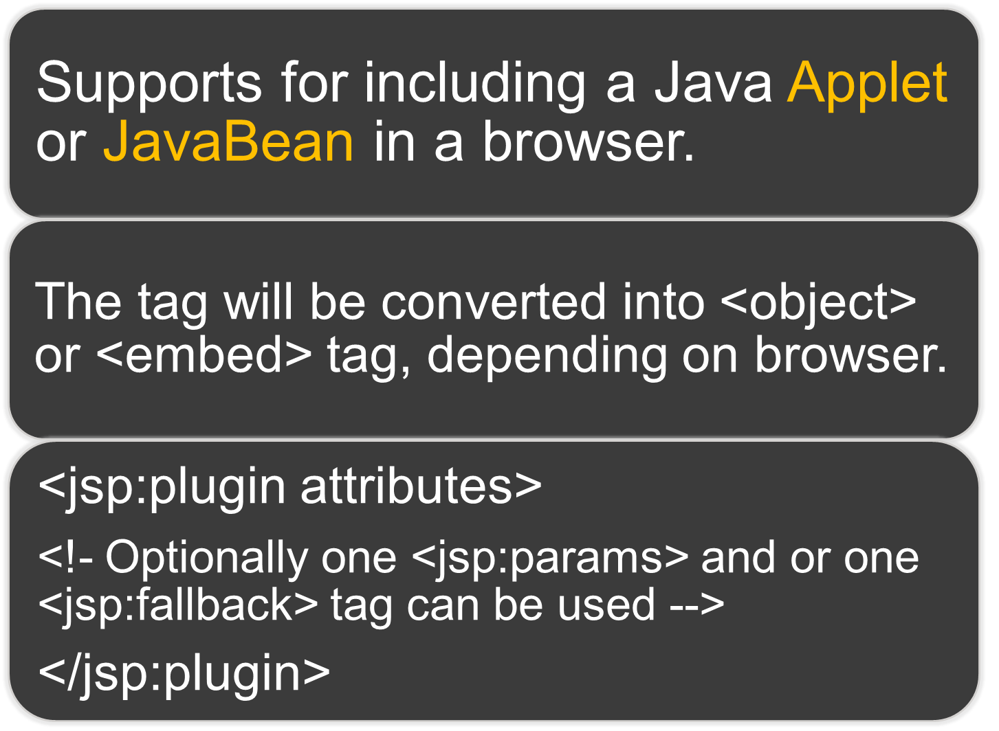

Slide 74
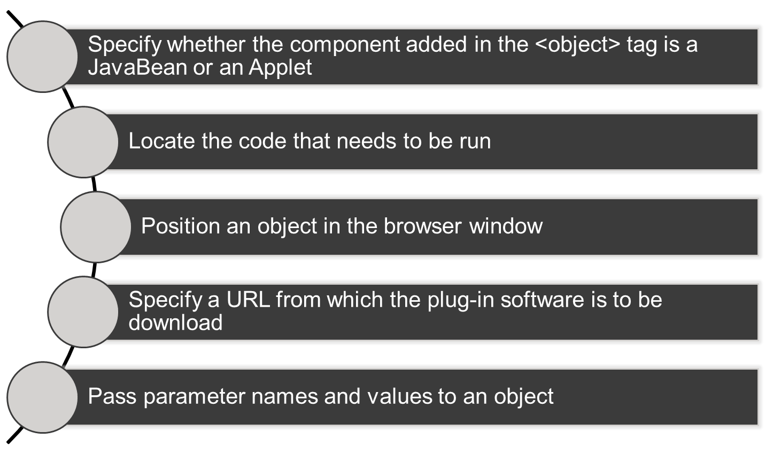
It performs the following tasks

Slide 75

Attribute | Description
type | One of two values can be set. applet or JavaBean.
code | A qualified class name of the object that has to be presented.
codebase | Base relative URL where the specified class can be located.
name | Name of the instance of JavaBean or an applet, which helps it to be invoked by the same JSP page to communicate with.
archive | Comma-separated list of pathnames. Which is used to locate archive files – preloaded with class loader that is present in the directory named codebase.
width | Width of the plugin.
height | Height of the plugin.
Notes:
‹#›

Slide 76
Attribute | Description
align | Position of an applet. Can be bottom, top, middle, left, right default is bottom.
hspace | A non-zero value to be set to the Left and Right of the applet or JavaBean.
vspace | A non-zero value to be set to the Top and Bottom of the applet or JavaBean.
jreversion | Version of Java Runtime Environment as required by the corresponding applet or JavaBean. Default is 1.2.
nspluginurl | URL from which a client can download the JRE plug-in as required for Netscape Navigator.
iepluginurl | URL from which a client can download the JRE plug-in as required for Internet Explorer.
Notes:
‹#›

Slide 77
<jsp:plugin height="500px“ width="500px" type="applet" code="pkg.Clock2.class"
nspluginurl=“http://www.java.sun.com/jre/"
iepluginurl =“http://www.java.sun.com/jre/" codebase="newFolder">
<jsp:fallback>
  Required Plugin Cannot Run!
  </jsp:fallback>
</jsp:plugin>

Slide 78
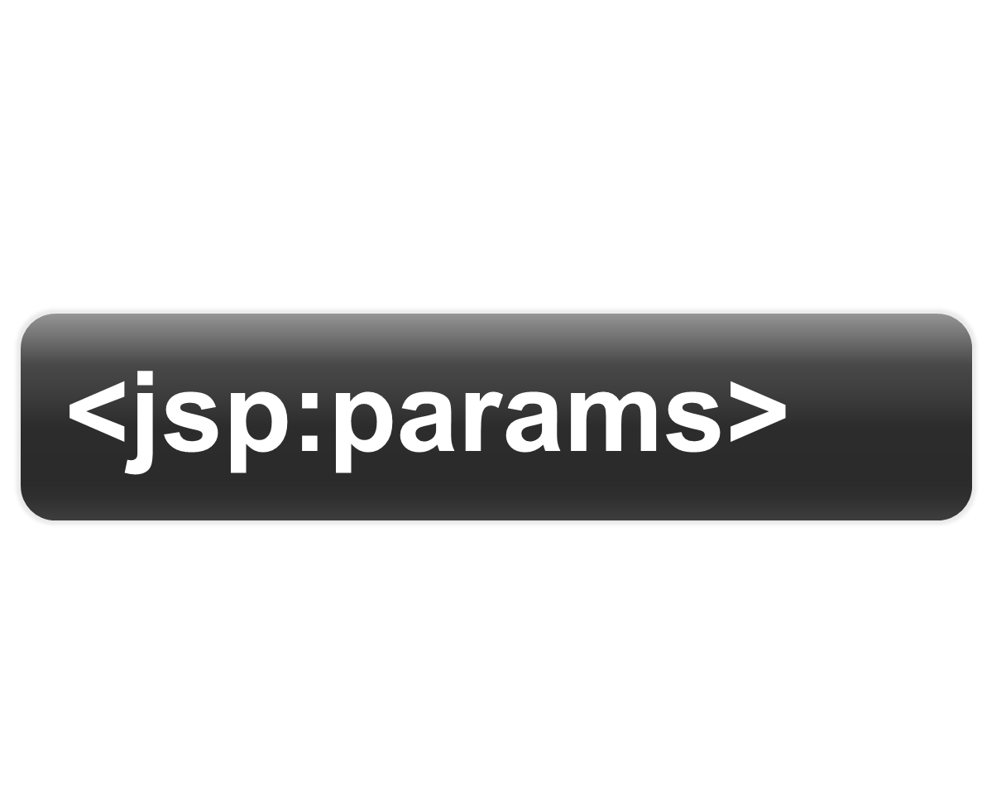

Slide 79
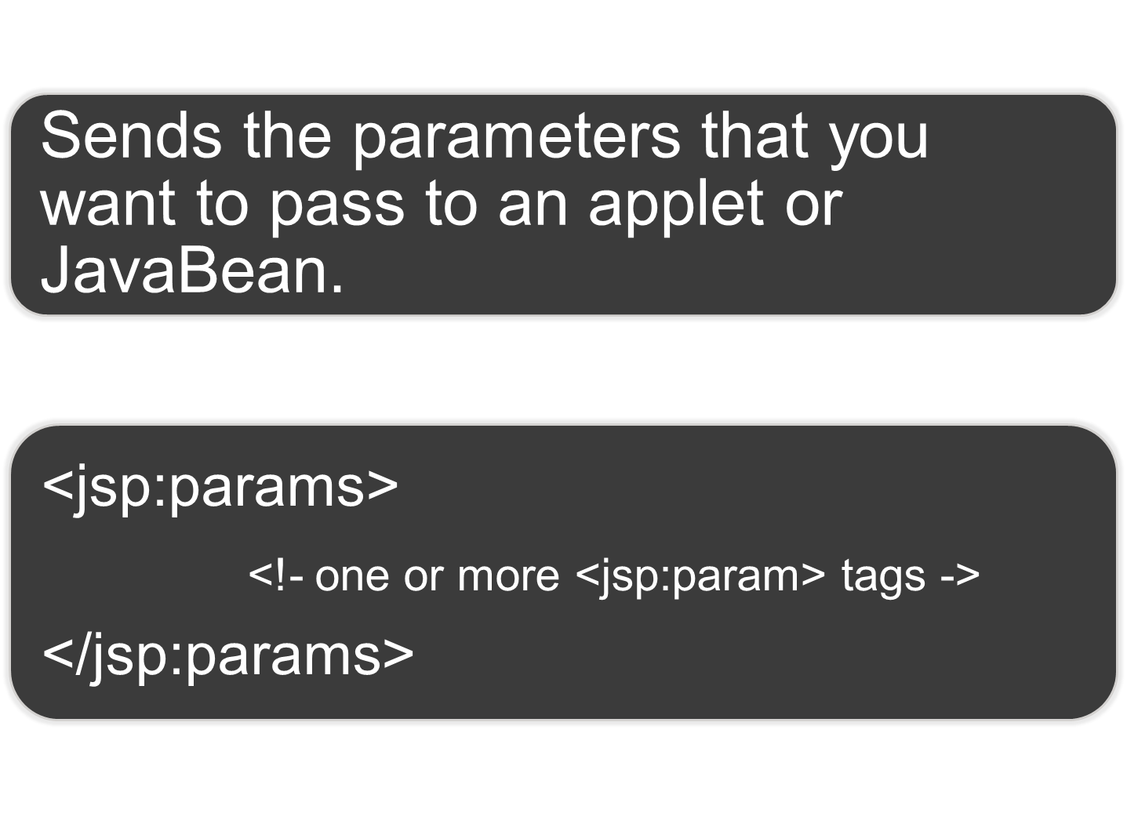

Slide 80
<jsp:plugin type="applet“ code="c1.class“>
<jsp:params>
<jsp:param name=“fn”>amit</jsp:param>
<jsp:param name=“ln”>gorvadiya</jsp:param>
</jsp:params>
</jsp:plugin>

Slide 81
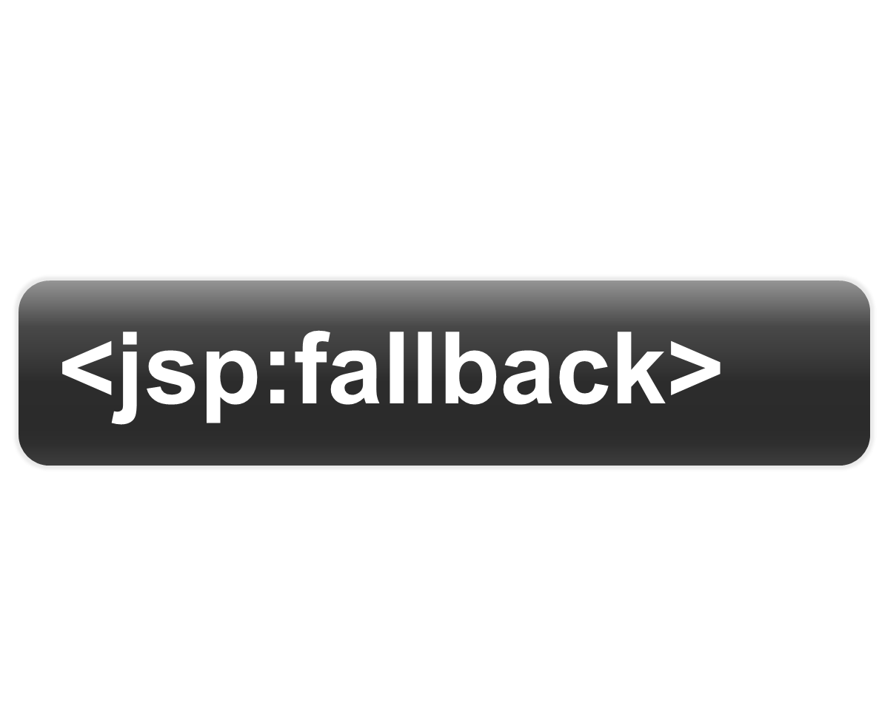

Slide 82
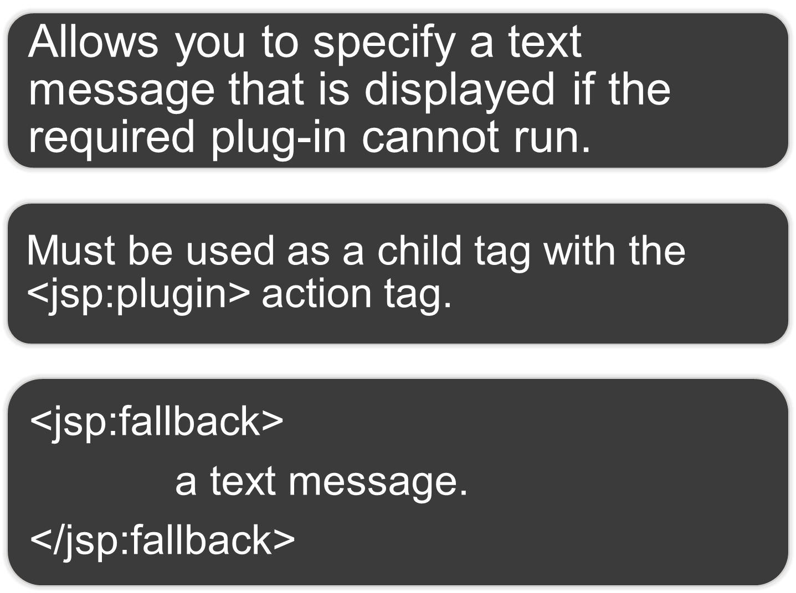

Slide 83
<jsp:plugin type="applet“ code="c1.class“>
<jsp:fallback>
a required plugin can not run!
</jsp:fallback>
</jsp:plugin>

Slide 84


Slide 85
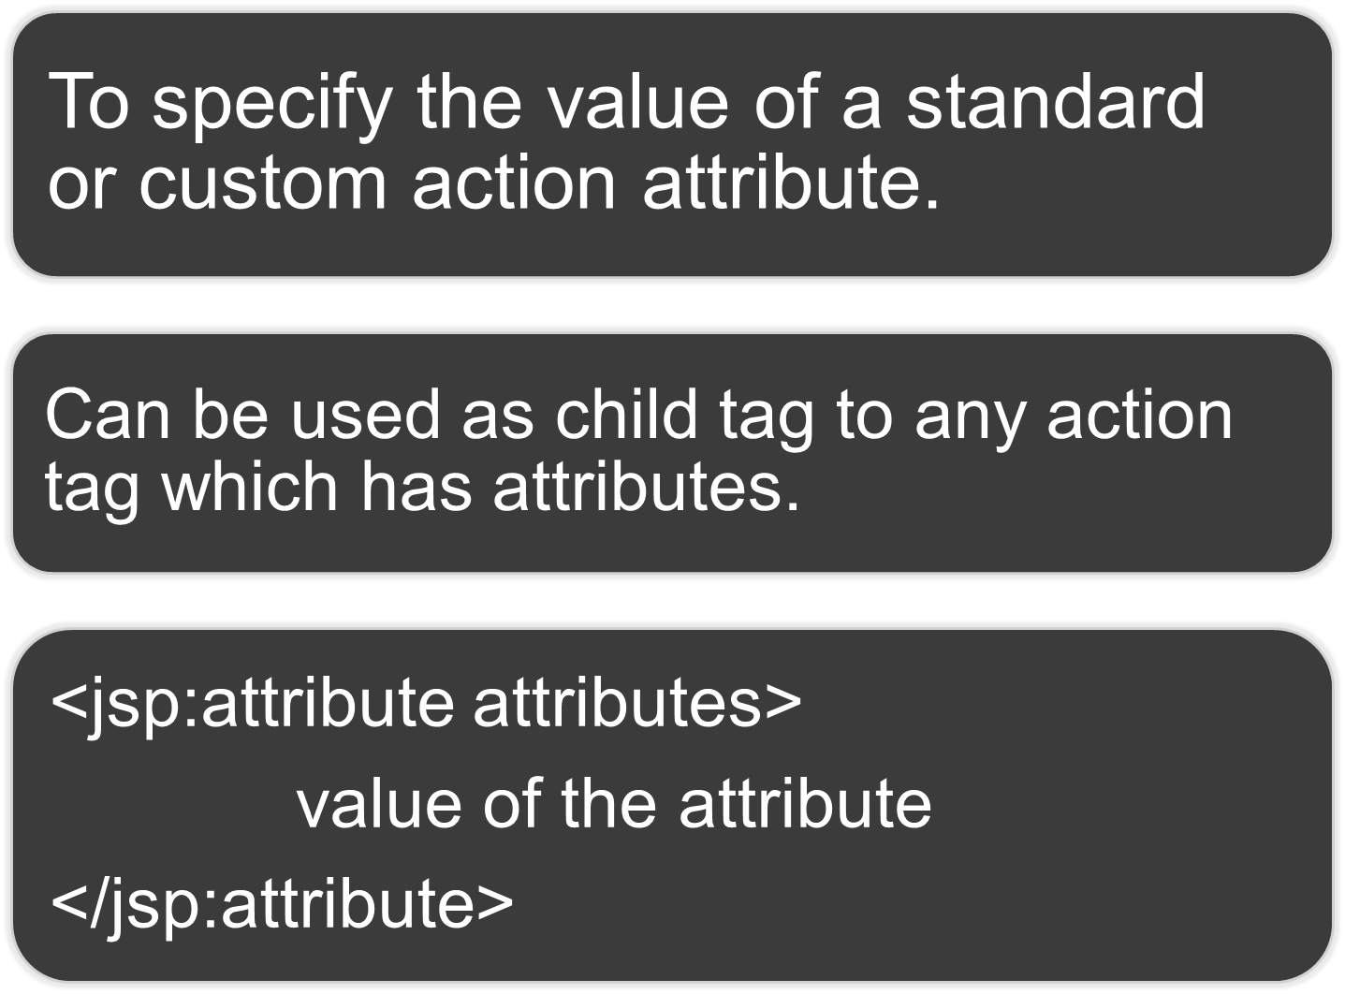

Slide 86


Attribute | Description
name | Specifies the attribute name that you want to se. Any of parent attributes.
trim | Default is true. Is white space allowed at the end of beginning? True means don’t allow, False means allow.
Note:
Notes:
‹#›

Slide 87
<jsp:useBean id=“myBean”>
<jsp:attribute name=“class” trim=“false”> pkg.myJavaBean </jsp:attribute>
</jsp:useBean>

Slide 88
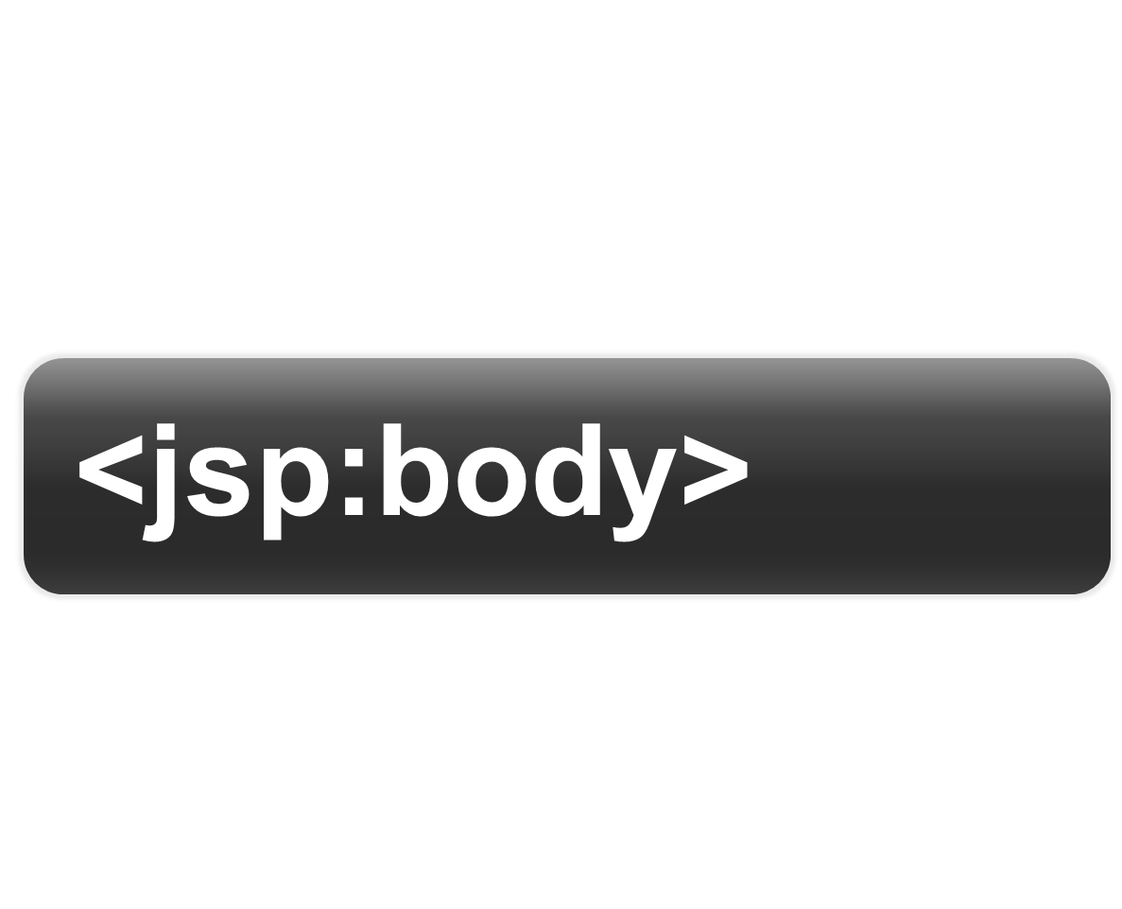

Slide 89


Slide 90
<jsp:useBean id=“myBean”>
<jsp:attribute name=“class” trim=“true” > pkg.RegForm </jsp:attribute>
<jsp:attribute name=“scope” > session </jsp:attribute>
<jsp:body>
<jsp:setProperty name=“myBean” property=“*” />
</jsp:body>
</jsp:useBean>

Slide 91


Slide 92


Slide 93
<jsp:element name=“myTag”
<jsp:attribute name=“width” > 500 </jsp:attribute>
<jsp:body>
  This is a Sample Body Text
</jsp:body>
</jsp:element>

Slide 94


Slide 95


Slide 96
<jsp:text>
  Sample text to display…
</jsp:text>

Slide 97


Slide 98


Slide 99


Slide 100



Slide 101



Slide 102



Slide 103



Slide 104



Slide 105



Slide 106



Slide 107



Slide 108



Slide 109

<%
ServletContext sc = config.getServletContext();
RequestDispatcher rd = sc.getRequestDispatcher(“/new.jsp”);
rd.forward(request,response);
%>

Slide 110



Slide 111


Slide 112

<%
HttpSession hs = pageContext.getSession();
hs.setAttribute("id", "gorvadiya@amit.com");
out.print(pageContext.getServletConfig(). getInitParameter("ServletSpecificParameter"));
out.print(pageContext.getServletContext(). getInitParameter("ApplicationLevelParameter"));
%>

Slide 113



Slide 114


Slide 115



Slide 116




Slide 117


request
HttpServletRequest
response
HttpServletResponse
*
out
JspWriter
session
HttpSession
config
ServletConfig
application
ServletContext
*
page
Object
*
pageContext
PageContext
*
exception
Throwable
*
Class

Slide 118


Slide 119


Slide 120



Slide 121


Slide 122


Slide 123


Slide 124

Some Methods

Slide 125

<%@page isErrorPage= “true” %>
<html>
<body>
The server has encountered following error
Exception<%=exception%>
Message<%=exception.getMessage()%>
Local Message<%= exception.getLocalizedMessage()%>
</body>
<html>

Slide 126


Slide 127


Slide 128

OR

Slide 129



<error-page>
<exception-type>
java.lang.NullPointerException
</exception-type>
<location>/error.html</location>
</error-page>
<html> <body>
<h1>
v r here bCoz of NULL Pointer Exception!
</h1>
</body> </html>

Slide 130



<error-page>
<exception-type>
java.lang.SQLException</exception-type>
<location>/error.jsp</location>
</error-page>
<@page isErrorPage=“true” %>
<html><body>
The server has encountered following error
<%=exception%>
<%=exception.getMessage()%>
<%=exception.getLocalizedMessage()%>
<%=exception.printStackTrace()%>
</body></html>

Slide 131


Slide 132


Slide 133



Slide 134


<%
try{
throw new JspException(“Generated JspException”);
}
catch(JspException je)
{
out.println(e);
}
%>

Slide 135


Slide 136


Slide 137



Slide 138



Slide 139



<%=request.getParameter(“uNm”))%>
<jsp:forward page=“Page2.jsp”/>
<html><body>
User Name : <%=request.getParameter(“uNm”)%>
</body></html>

Slide 140



Slide 141

<%=session.setAttribute(“uNm”, “ram”))%>
<jsp:forward page=“Page2.jsp”/>
<html><body>
User Name : <%=session.getAttribute(“uNm”)%>
</body></html>

Slide 142



Slide 143
<%=application.setAttribute(“uNm”, “ram”))%>
<jsp:forward page=“Page2.jsp”/>
<html><body>
User Name : <%=application.getAttribute(“uNm”)%>
</body></html>

Slide 144


Slide 145


